Slide 1

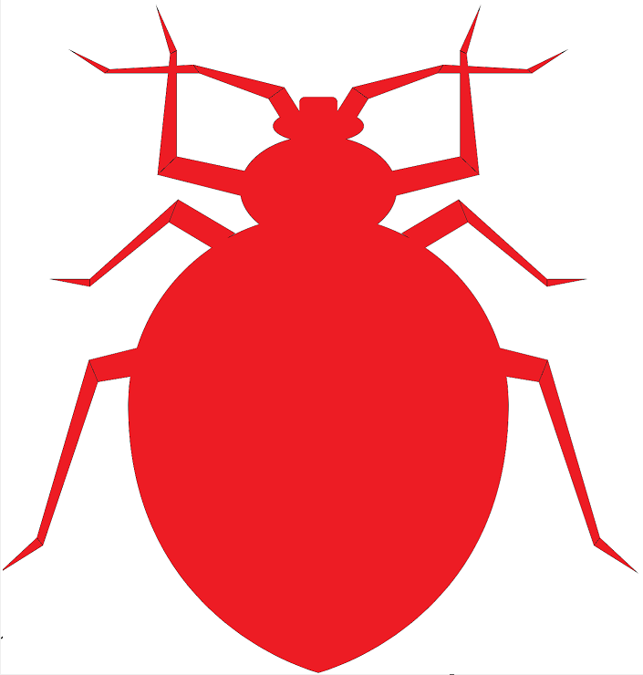
Sexual conflict and sexual networks in bed bugs: Mate choice, sperm competition, and the fitness cost of
traumatic insemination
Janice Yan and Reuven Dukas
Notes:
Hi everyone, I’m Janice and thanks for joining me today for my talk on sexual conflict and sexual networks in bedbugs.

Slide 2
Overview
1. Background and rationale
1. Background and rationale
2. Social consequences of sexual conflict
2. Social consequences of sexual conflict
3. Sexual networks of bed bugs
3. Sexual networks of bed bugs
4. Cost of traumatic insemination
4. Cost of traumatic insemination
5. Ongoing experiments
5. Ongoing experiments

Slide 3
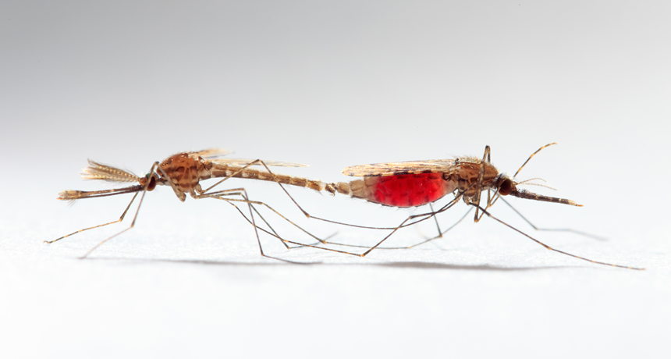
Sexual conflict occurs when the reproductive interests of males and females are at odds with one another
Parker (1979)

Slide 4
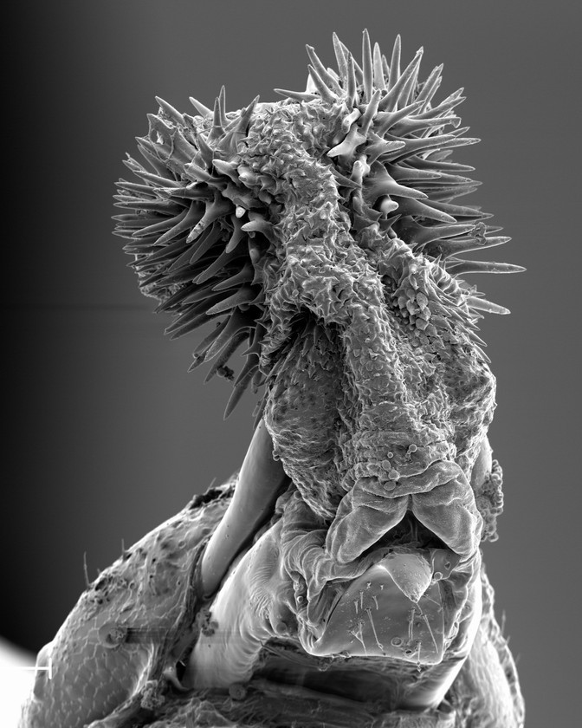
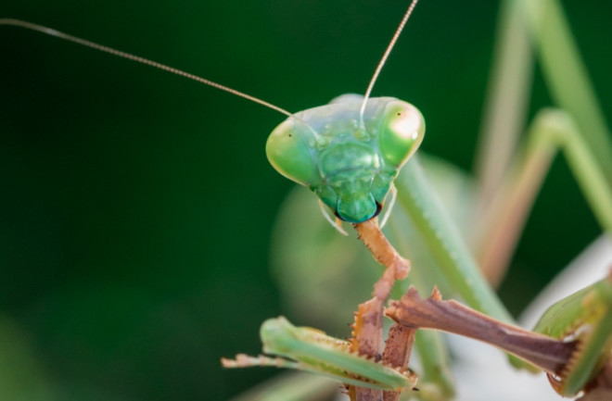
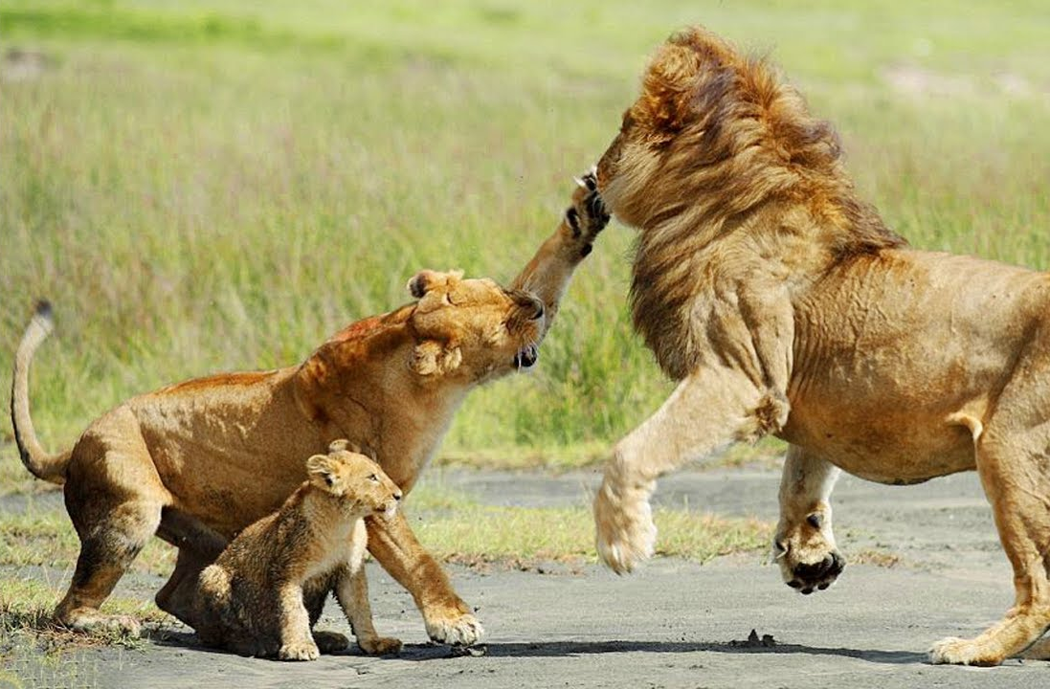
Sexual conflict occurs when the reproductive interests of males and females are at odds with one another
Sexual cannibalism
Hooked and barbed genitalia
Infanticide
Arnqvist et al. (2021); Lawrence (1992); Pusey and Packer (1994)
Notes:
Sexual conflict is widely prevalent in the animal kingdom leading to the evolution of extreme morphological traits like spiky genitalia or extreme behaviours like sexual cannibalism and infanticide.

Slide 5
Goal: Study social and sexual dynamics of a model system with extreme sexual conflict
Males
Females
Fitness
Number of matings

Slide 6
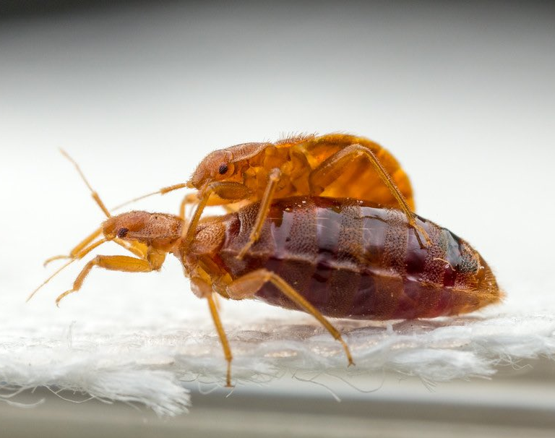
Bed bugs as a model organism
Often cited as an example of sexual conflict as they have obligate traumatic insemination
Form aggregations and use aggregation/alarm pheromones
Stutt and Siva-Jothy (2001), Reinhardt and Siva-Jothy (2007)
Notes:
And so given the prevalence of sexual conflict across many animal systems and its clear impact on evolution.. the overarching goal of my research is to study the sexual dynamics and behaviours of a model system with extreme sexual conflict. Which is why we turn to bedbugs as they’re famous for having intense sexual conflict since they always reproduce through traumatic insemination. Traumatic insemination is when the male bypasses the female’s reproductive tract, pierces her abdomen and deposits sperm straight into her body cavity and there’s data suggesting that repeat inseminations are highly costly to females.

Slide 7
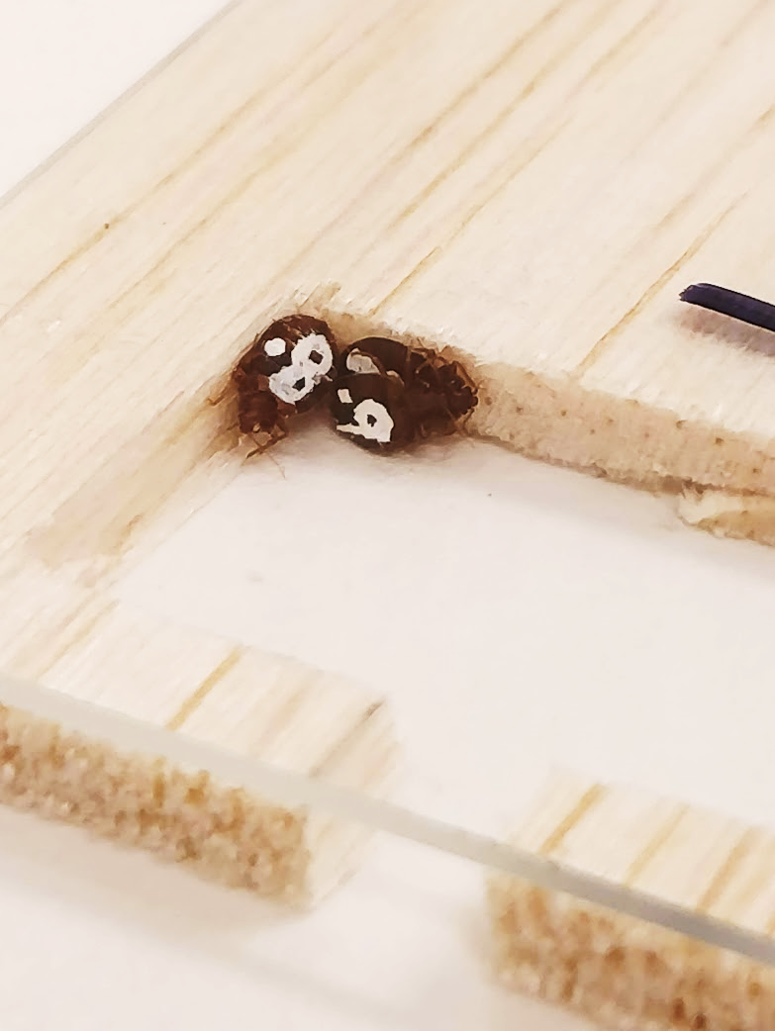
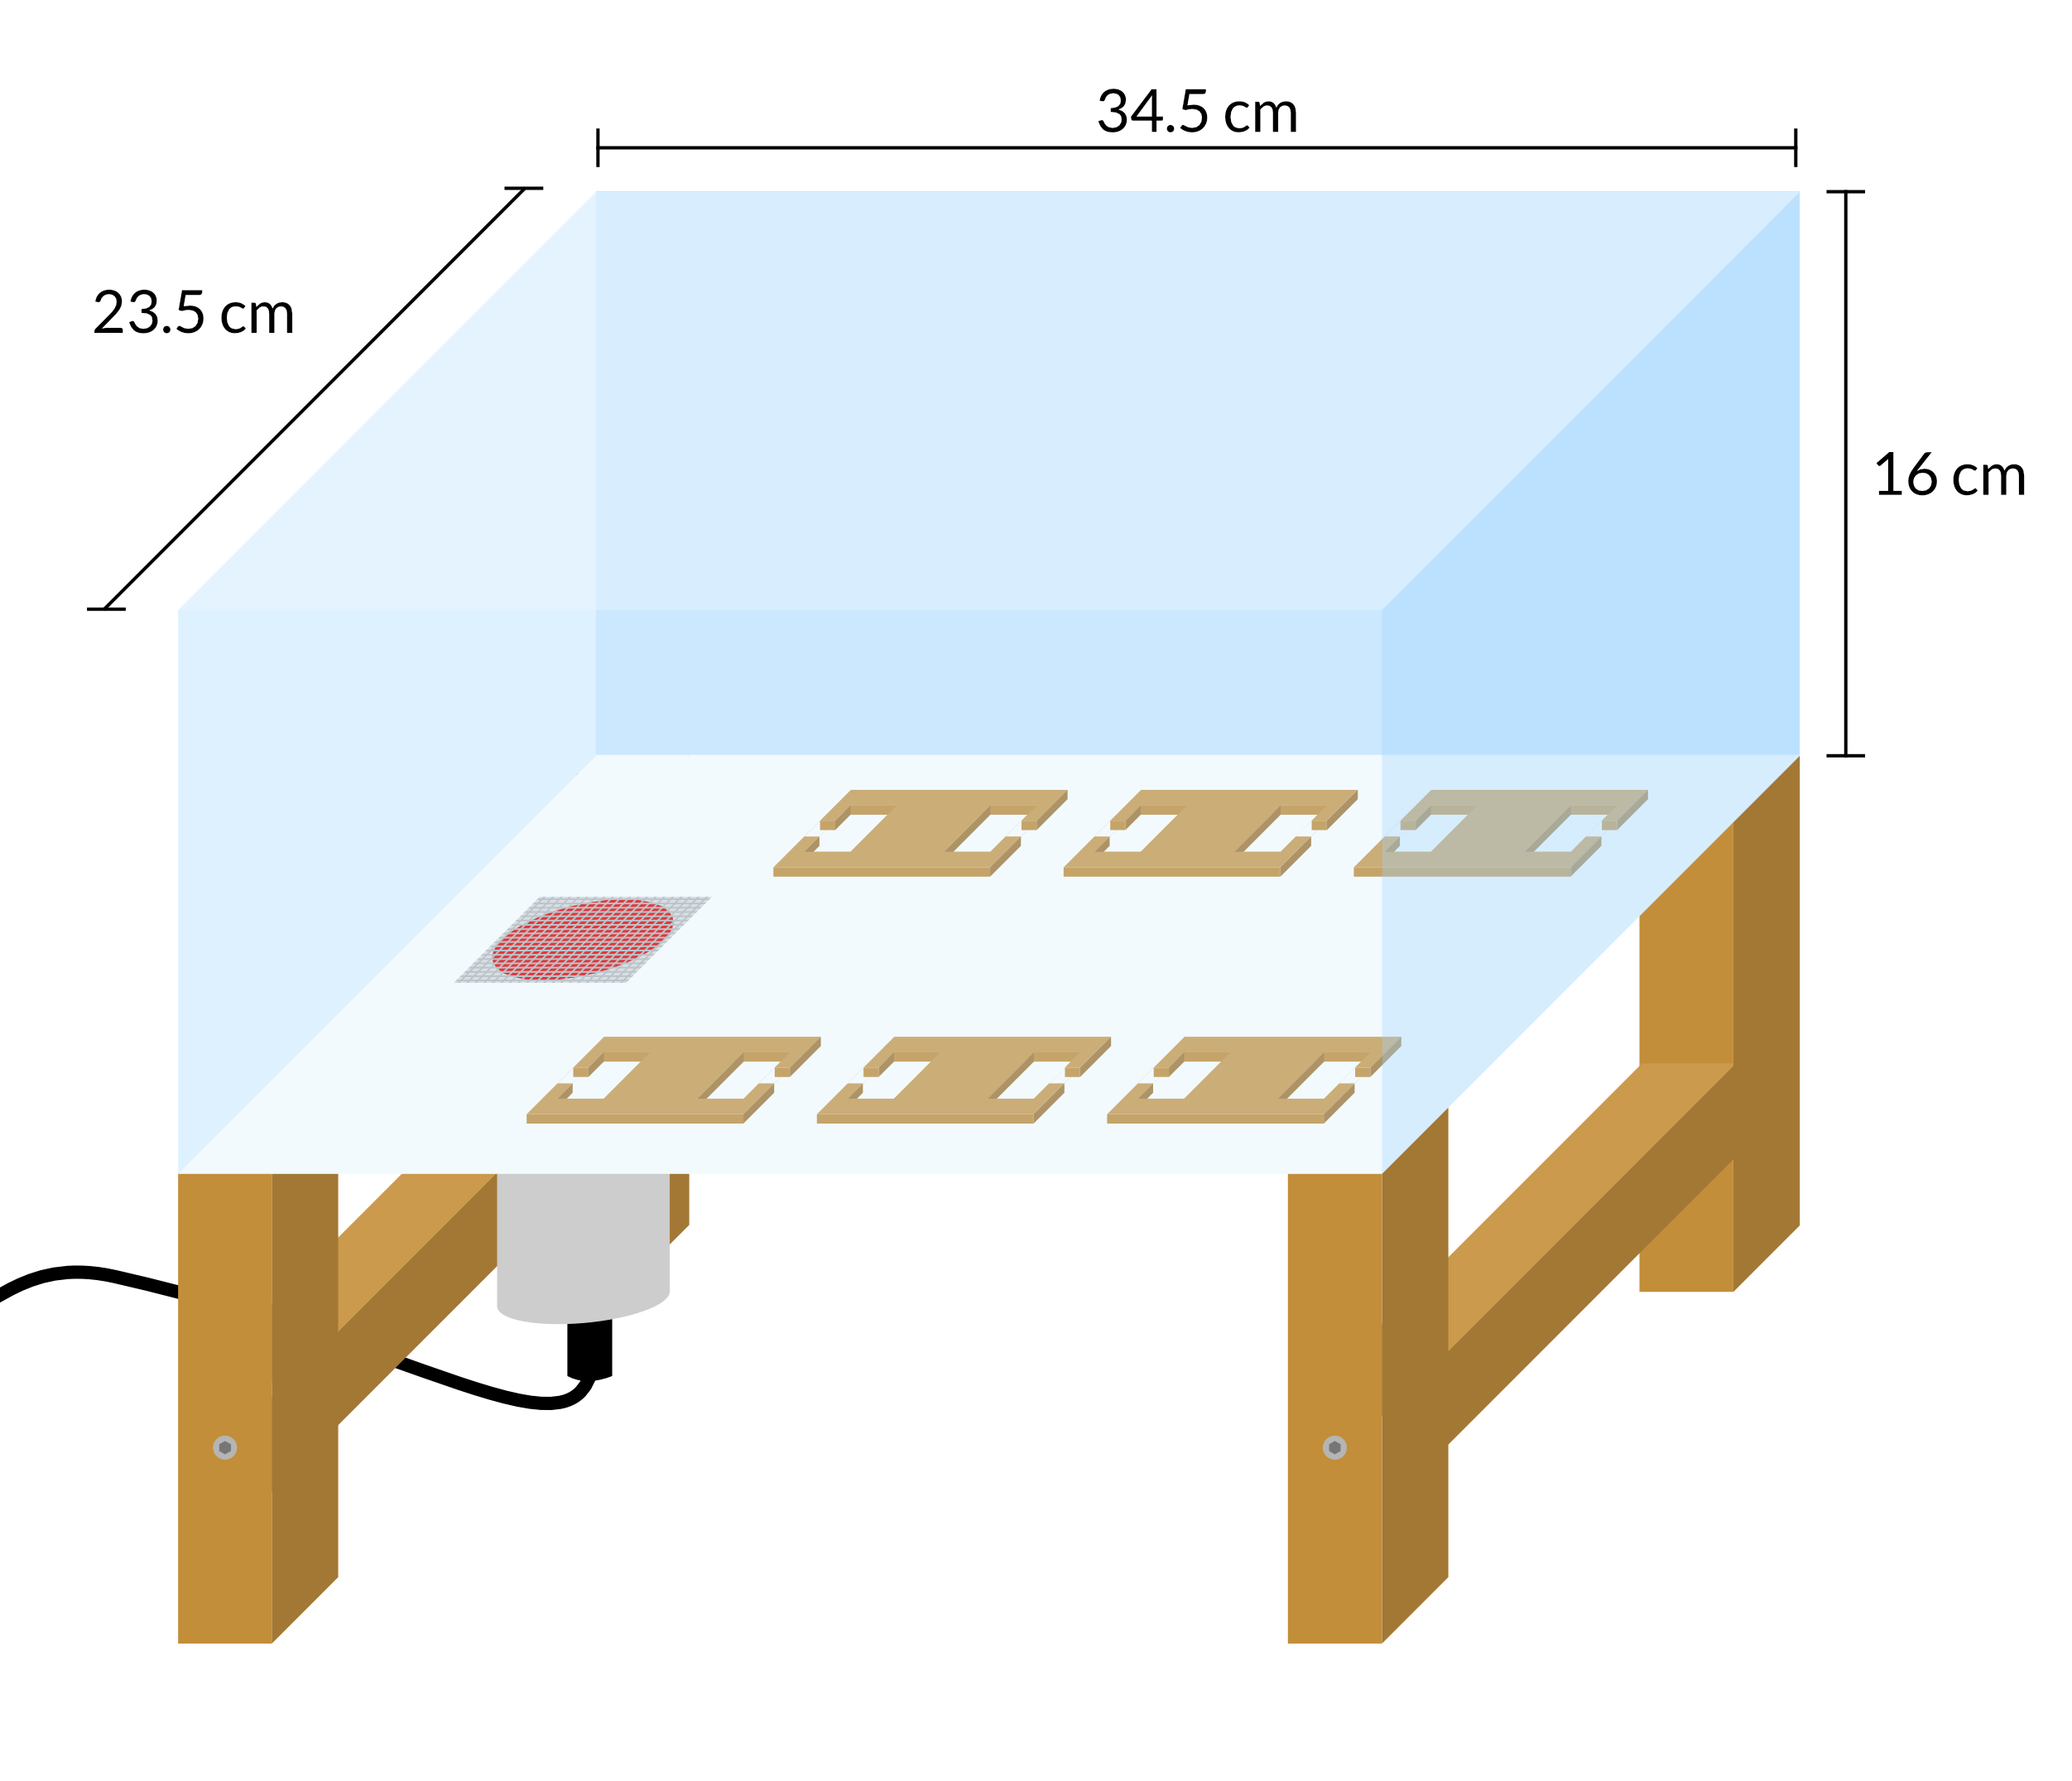
We developed a semi-naturalistic arena to study potential female social responses to sexual conflict
Heated blood source
Shelters
Tracked aggregation patterns of six bed bug populations (12 M, 12 F) over 6 days
Yan and Dukas (in press)
Notes:
So the first thing we did to study their sexual dynamics, we developed a naturalistic arena to observe individually marked bed bugs as shown here In this arena, the bed bugs are allowed to freely roam between several high-quality shelters and also feed from our “artificial host” By observing the groups of bed bugs continuously for six days and recording all sexual interactions, we were able to gain some compelling insights that then inspired further experiments…

Slide 8
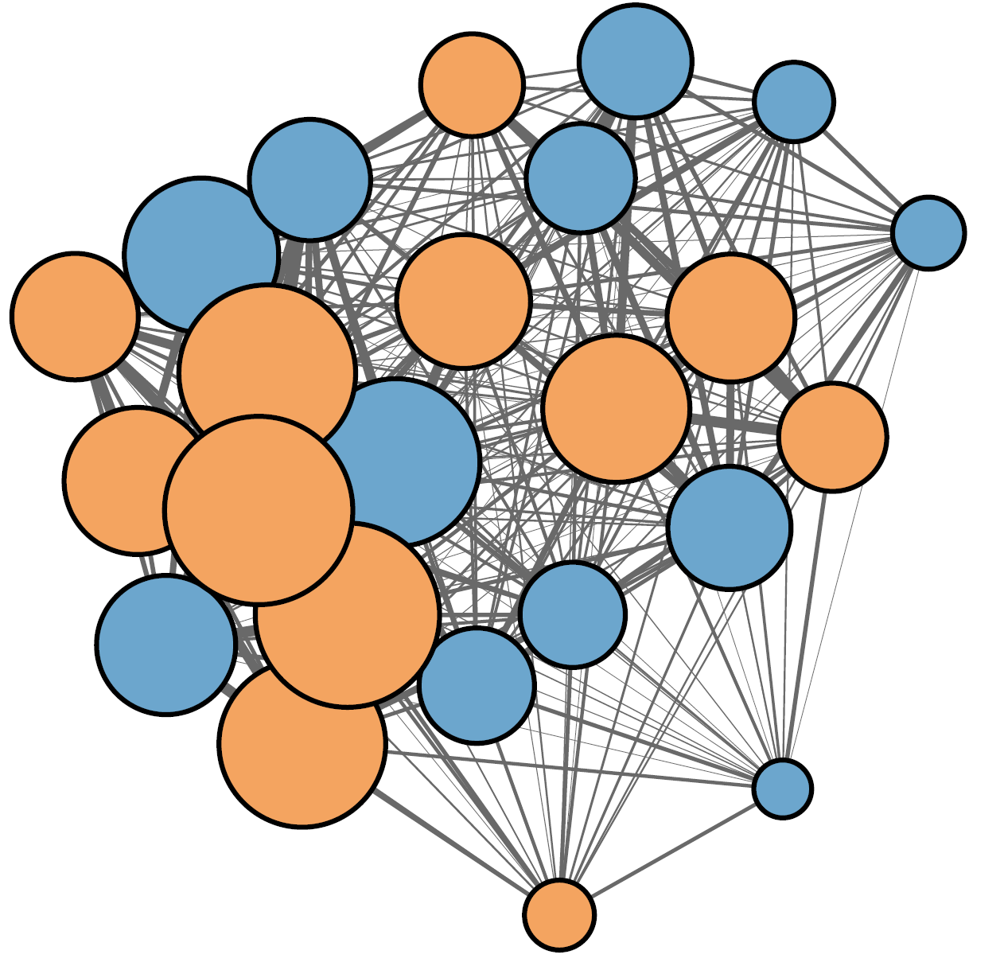
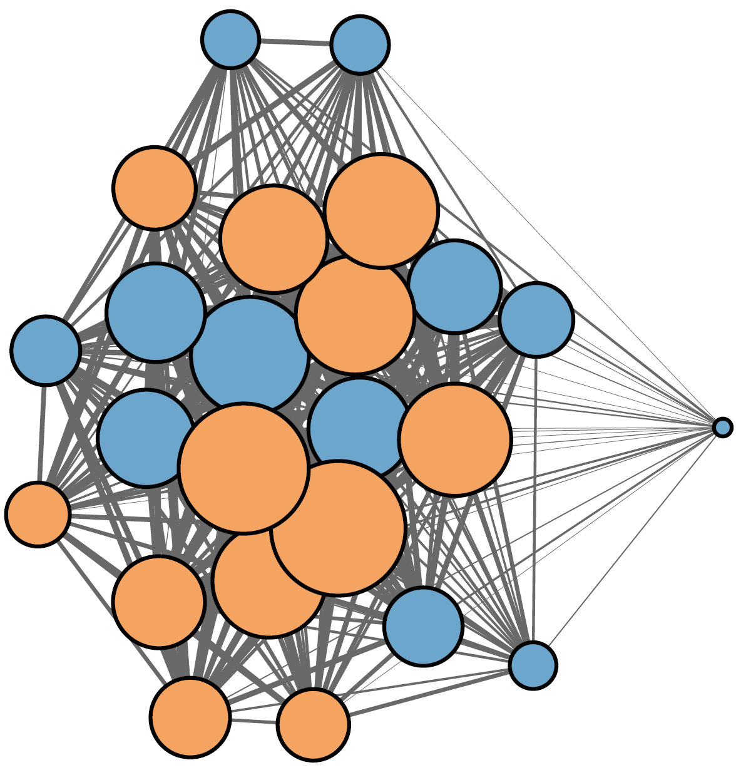
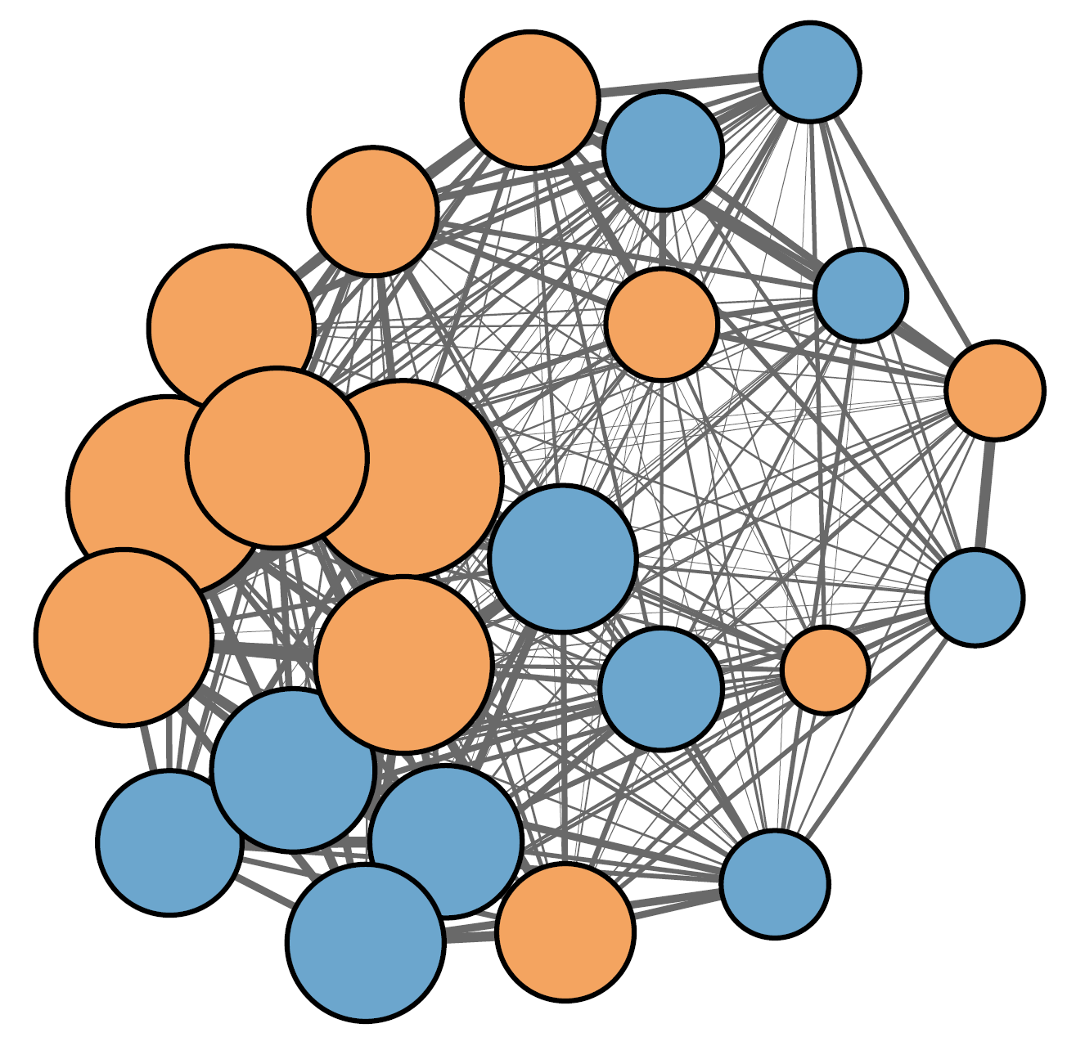
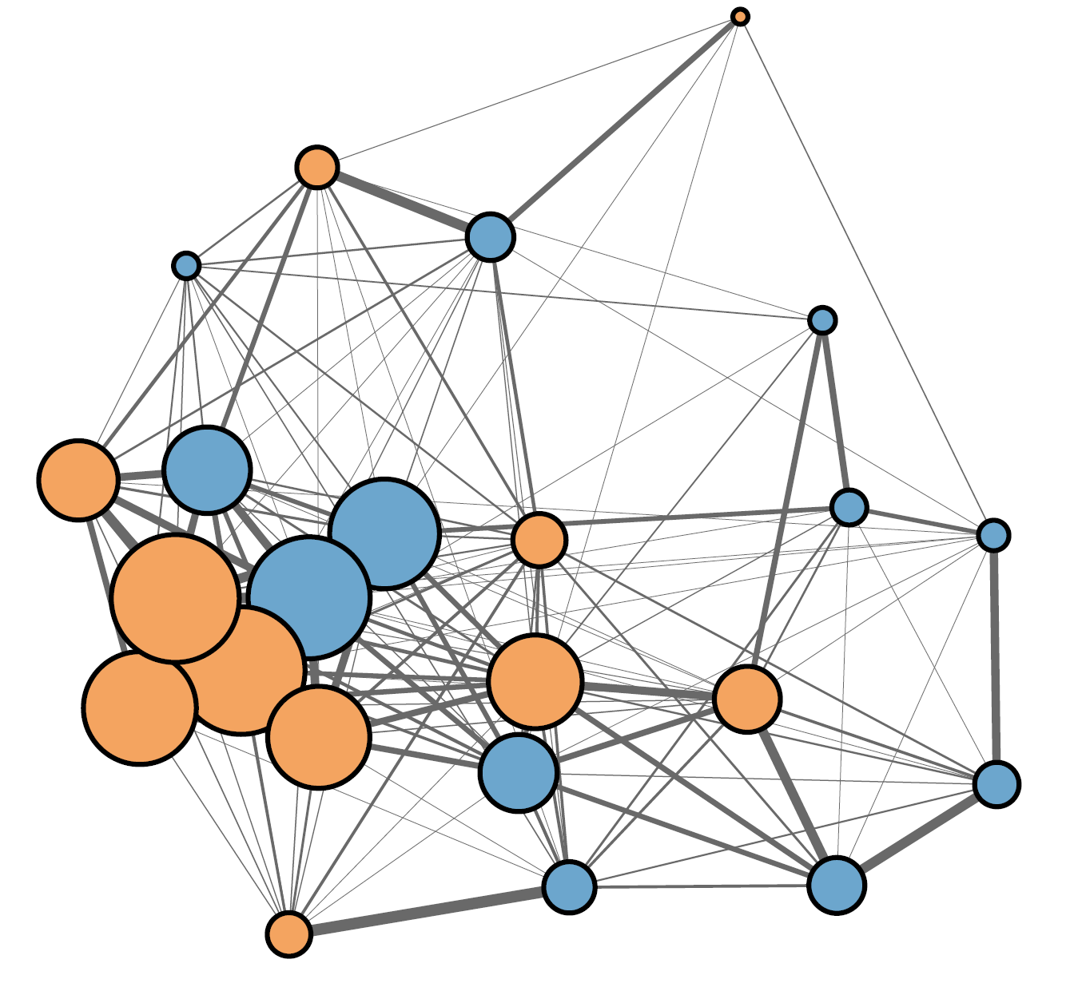
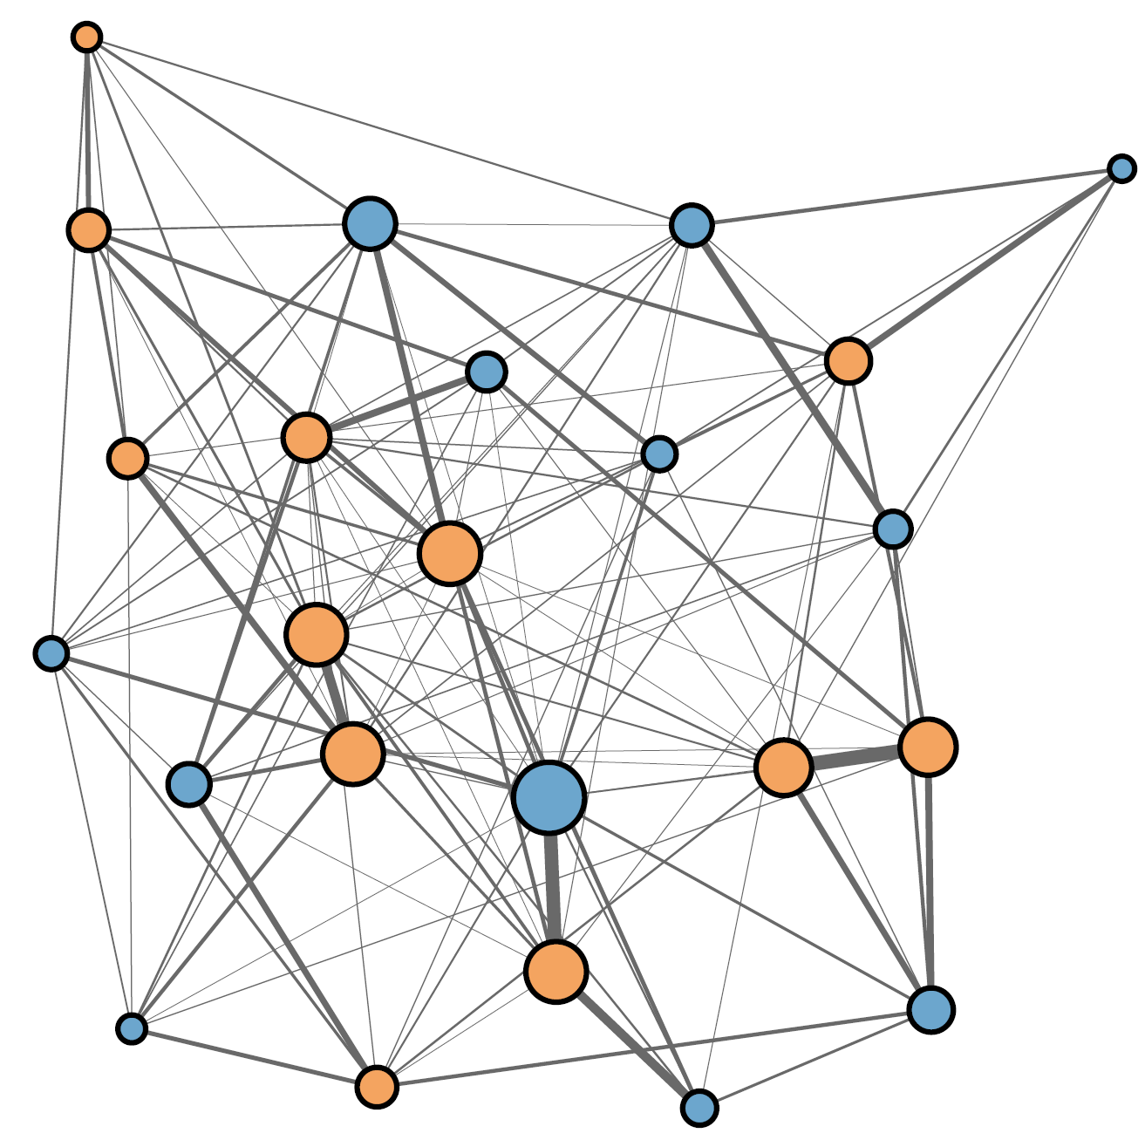
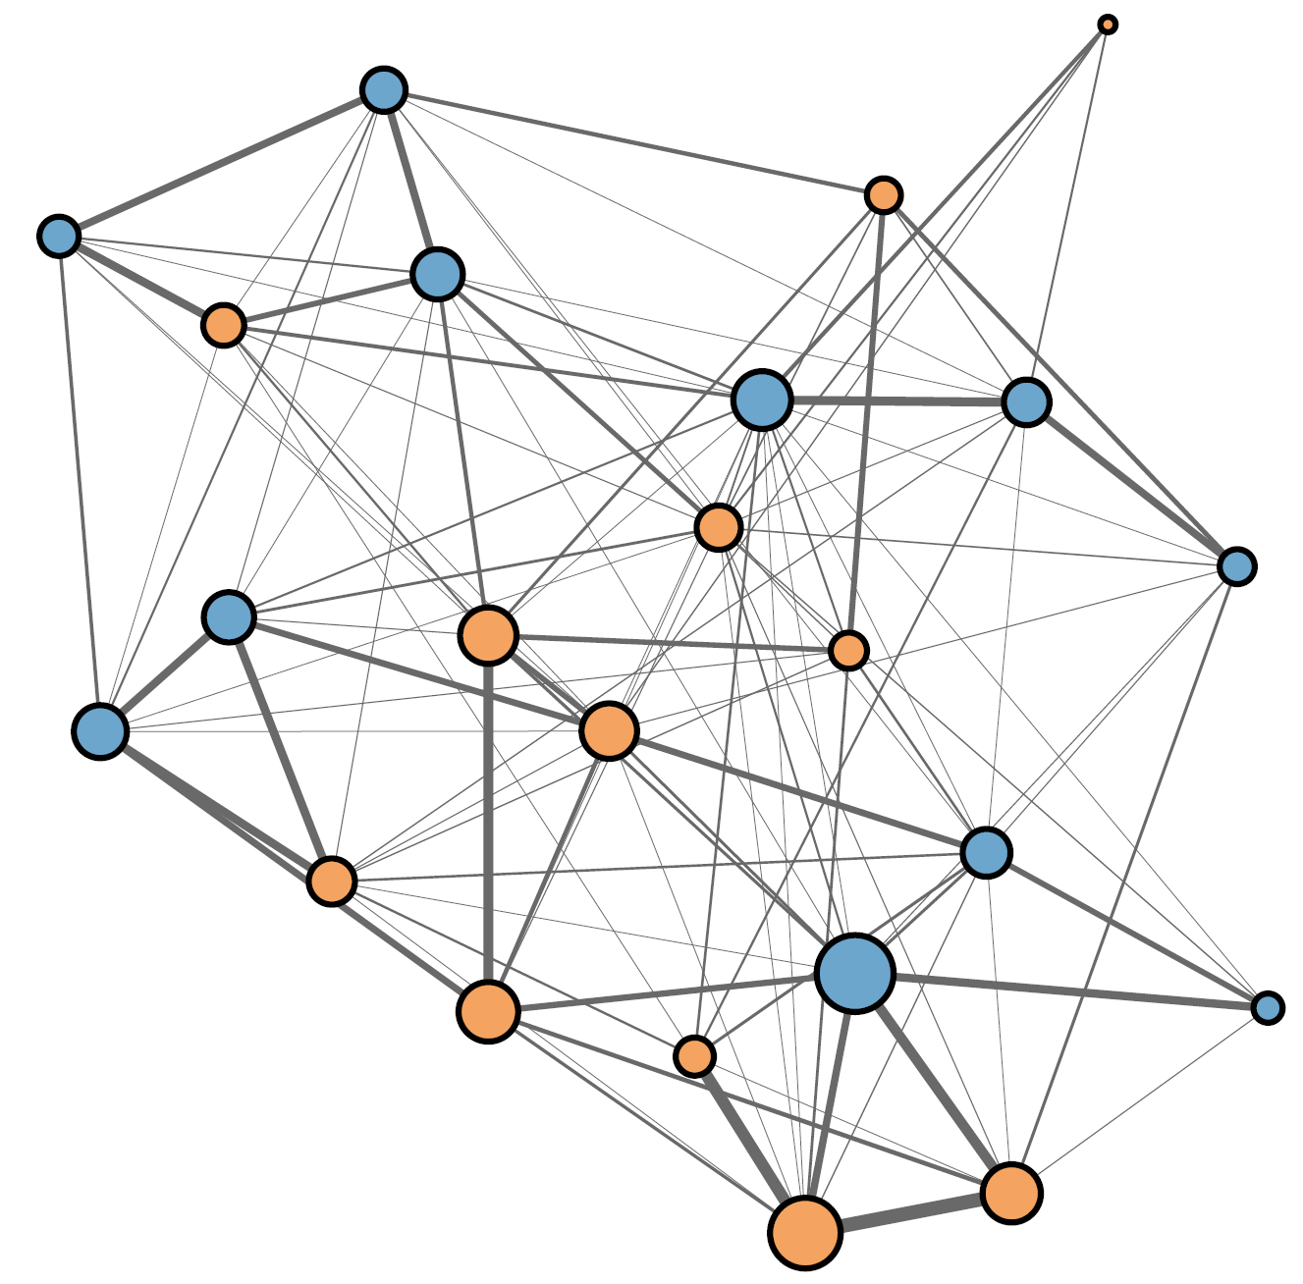
Aggregation networks
2-shelter
Male Female
Node size represents network strength
12-shelter
Yan and Dukas (in press)
Notes:
And no evidence for sex differences in the 12-shelter treatment So this doesn’t support our prediction that females avoid harassment by simply being less social.

Slide 9
Females did not form fewer and weaker social connections compared to males
2-shelter
Male Female
Node size represents strength
12-shelter
Yan and Dukas (in press)
Notes:
And no evidence for sex differences in the 12-shelter treatment So this doesn’t support our prediction that females avoid harassment by simply being less social.

Slide 10
Females did not selectively aggregate with other females
2-shelter
Male Female
Node size represents strength
12-shelter
Yan and Dukas (in press)
Notes:
And no evidence for sex differences in the 12-shelter treatment So this doesn’t support our prediction that females avoid harassment by simply being less social.

Slide 11
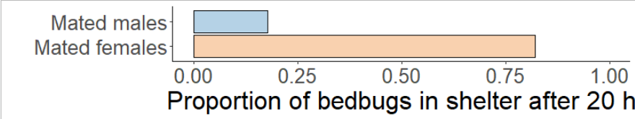

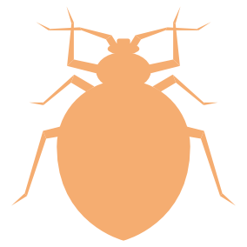
We tested the social preferences of females in isolation
p < 0.01
N = 28
In isolation, females prefer the company of other females
Sexual conflict over the social environment
Yan and Dukas (in press)

Slide 12
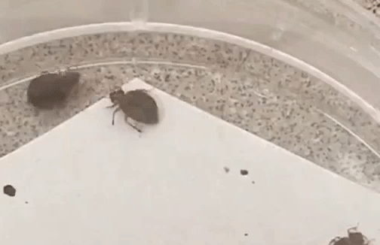
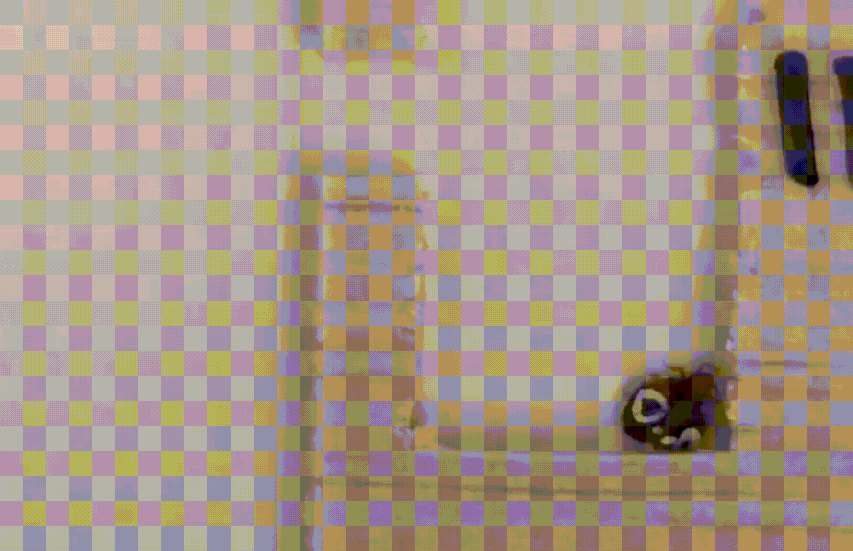
As we tracked bed bug aggregations, we also documented all sexual interactions
Mounts (attempted inseminations)
Inseminations

Slide 13
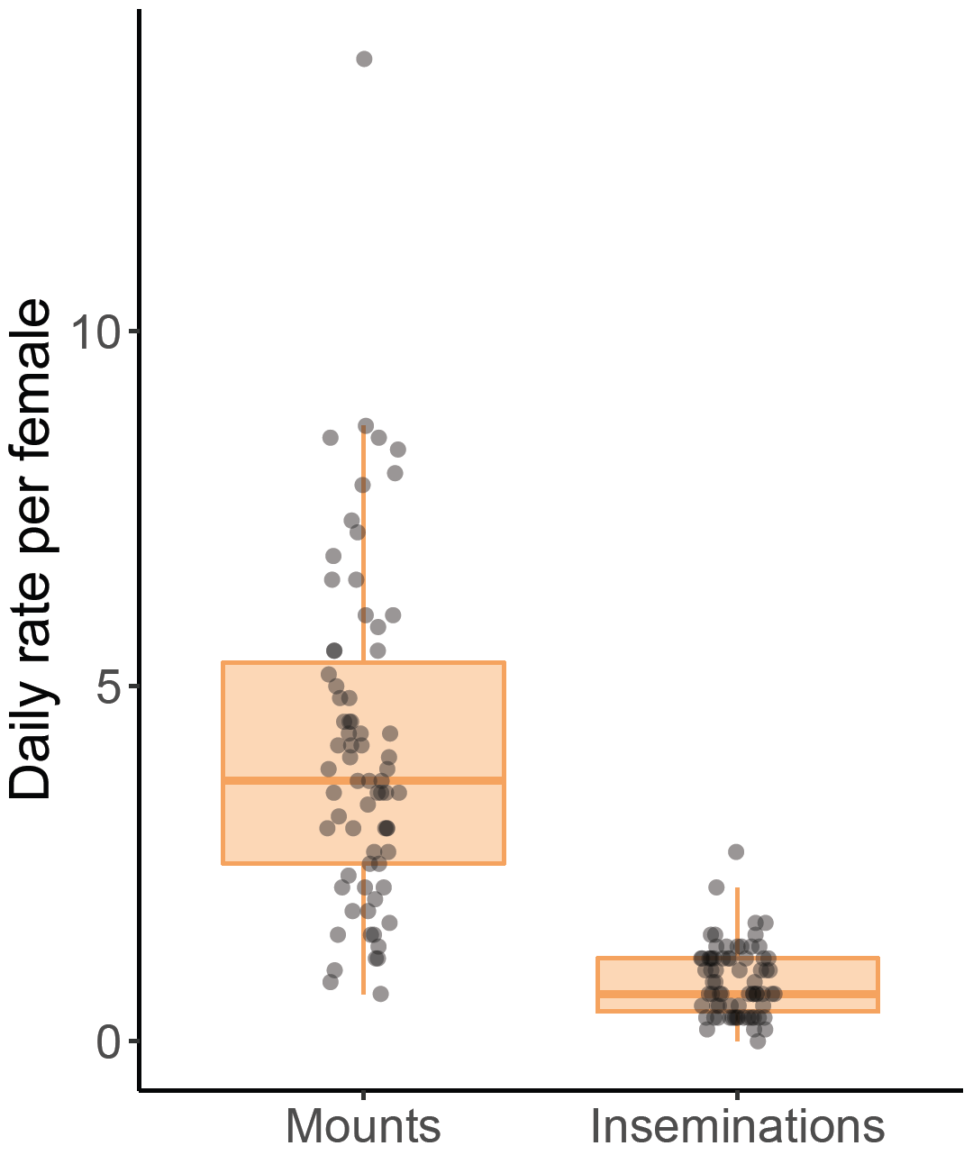
Not all mounts led to insemination
Is the high mount to insemination ratio based on female insemination status?
Driven by male choice or female avoidance?
Yan and Dukas (in press)
Notes:
First, we found that not all insemination attempts, or mounts, led to insemination.. so while females were getting mounted roughly 4-5 times a day, they only got insemination around once a day. So obviously we questioned why this is the case and specifically, whether this pattern is driven by male choice or female avoidance…

Slide 14


We experimentally manipulated female insemination status to see its effect on female avoidance and male rejection
Recently inseminated female
x 6
x 12
Distantly inseminated female
x 6
Male
Recently inseminated: Mated two days prior + immediately before the experiment
Distantly inseminated: Mated two days prior to the experiment
5 replicates in total resulting in 30 females per treatment
Notes:
And so in other words we hypothesized that female mating status would affect both female avoidance and male rejection behaviour and decided to critically test this by experimentally manipulating female insemination status. To do this, we once again observed groups of 24 mixed sex adult bedbugs except this time, 6 of the females were experimentally manipulated to be recently inseminated while 6 were left as distantly inseminated. How we did this was mate the recently inseminated females two days prior and immediately before the observation period while distantly inseminated females were only mated two days prior. And in total we ran 5 replicates resulting in 30 females per treatment.

Slide 15
Quantifying female avoidance and male abort rates
Female succeeds
Female avoids
Attempted avoidances
Female avoidance rate
Female fails
=
Mounts
Mount
Male aborts
Male aborts
Female stays
Male abort rate
=
Mounts where female stayed
Insemination
Notes:
And so to walk you guys through how we observe sexual interactions.. Every time we saw a mount, we noted whether the female tried to avoid or whether she stayed still. In cases where the female tries to avoid, she can either succeed or fail. If she succeeds, then naturally insemination does not happen. However, if she fails, we treat it as if she stays and then of all the females who stay, we then note whether the male aborts the mount or if he follows through with insemination.

Slide 16
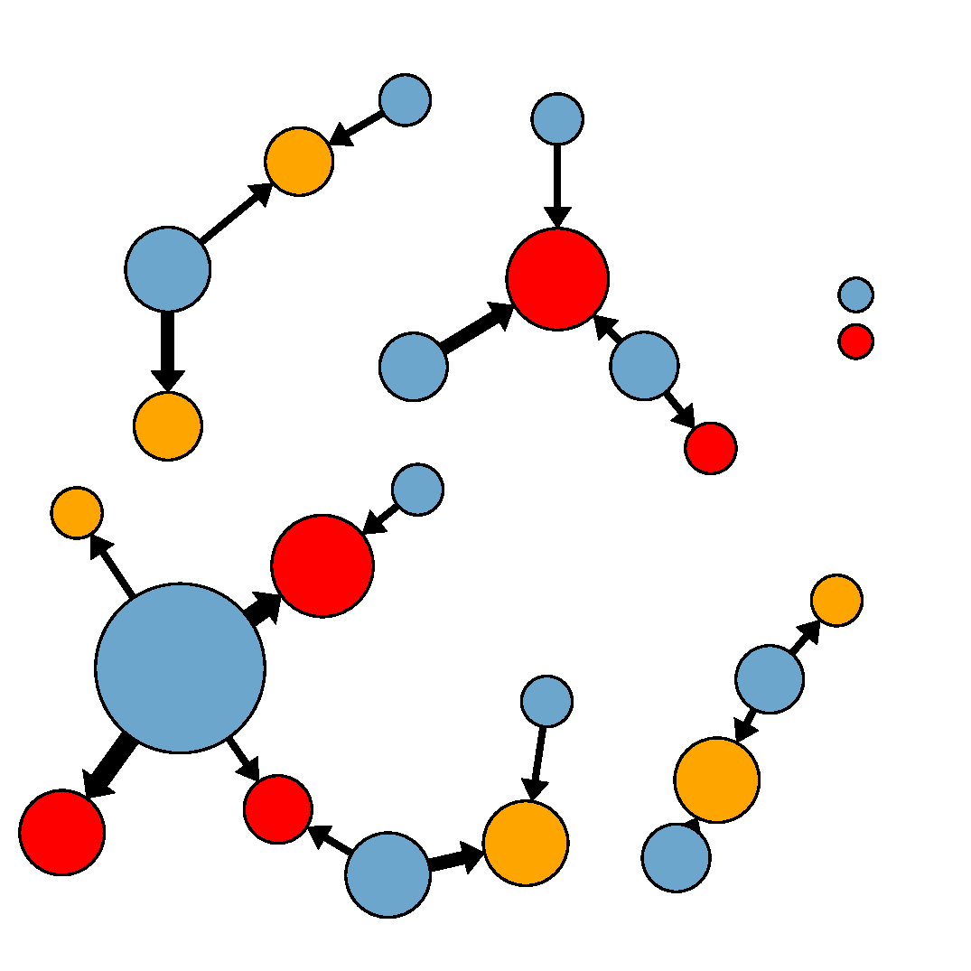
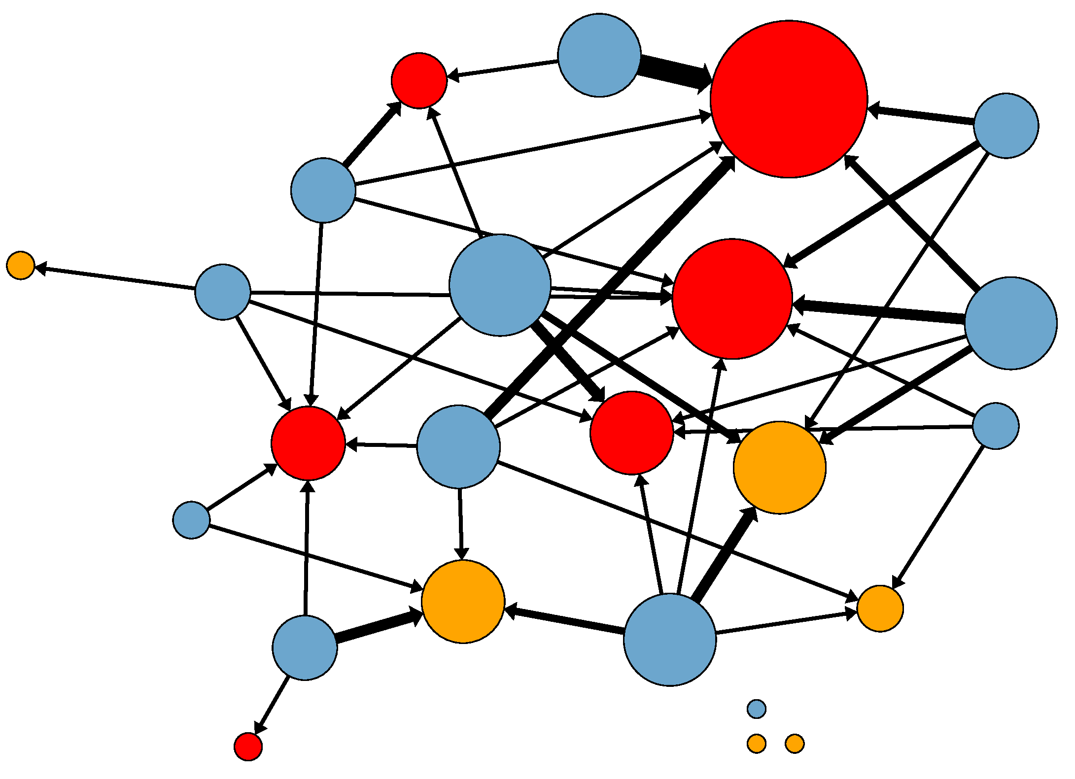
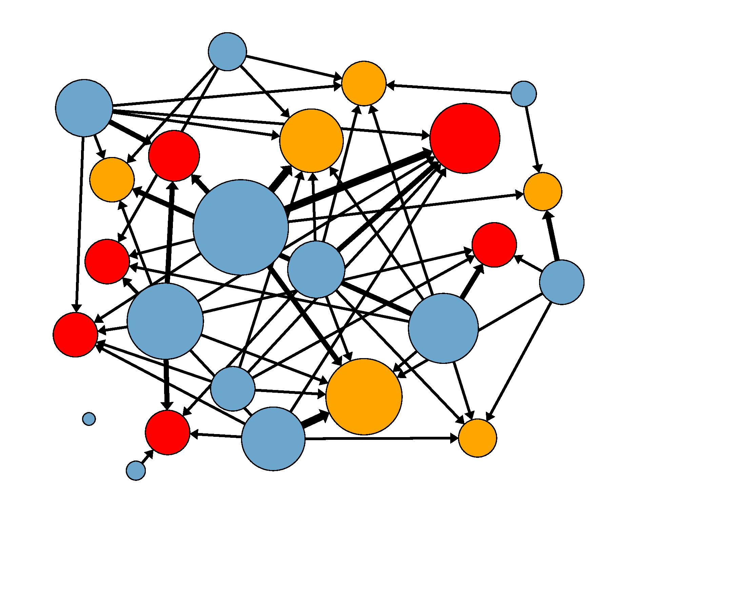
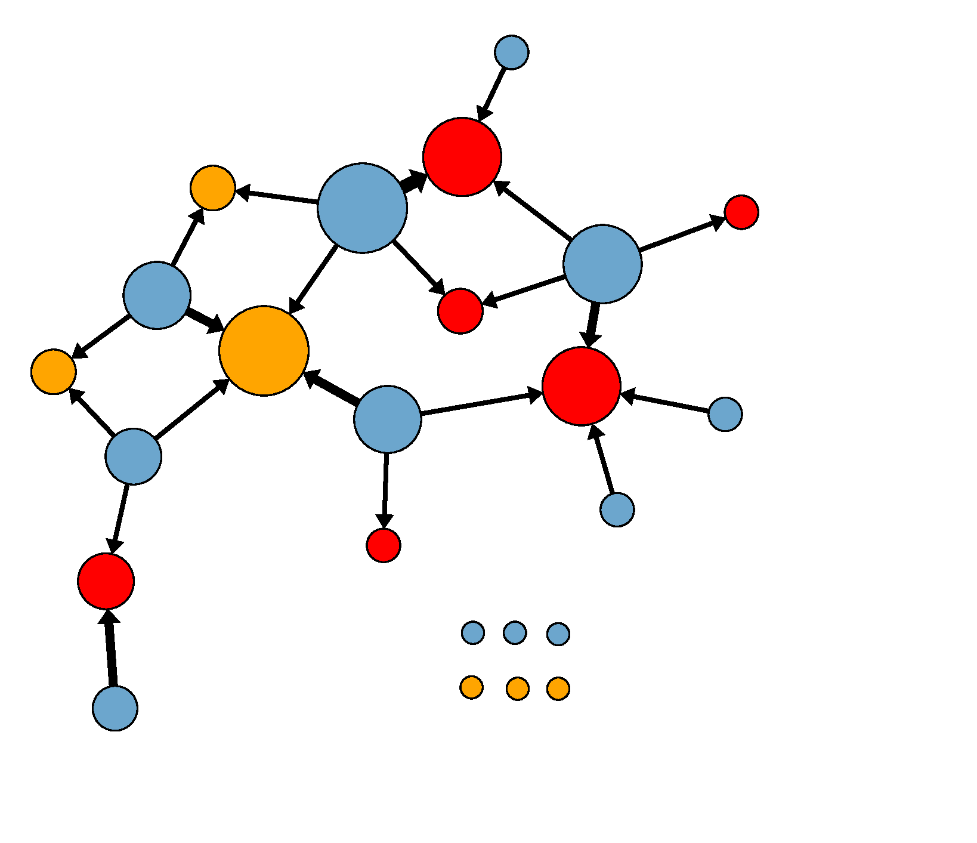
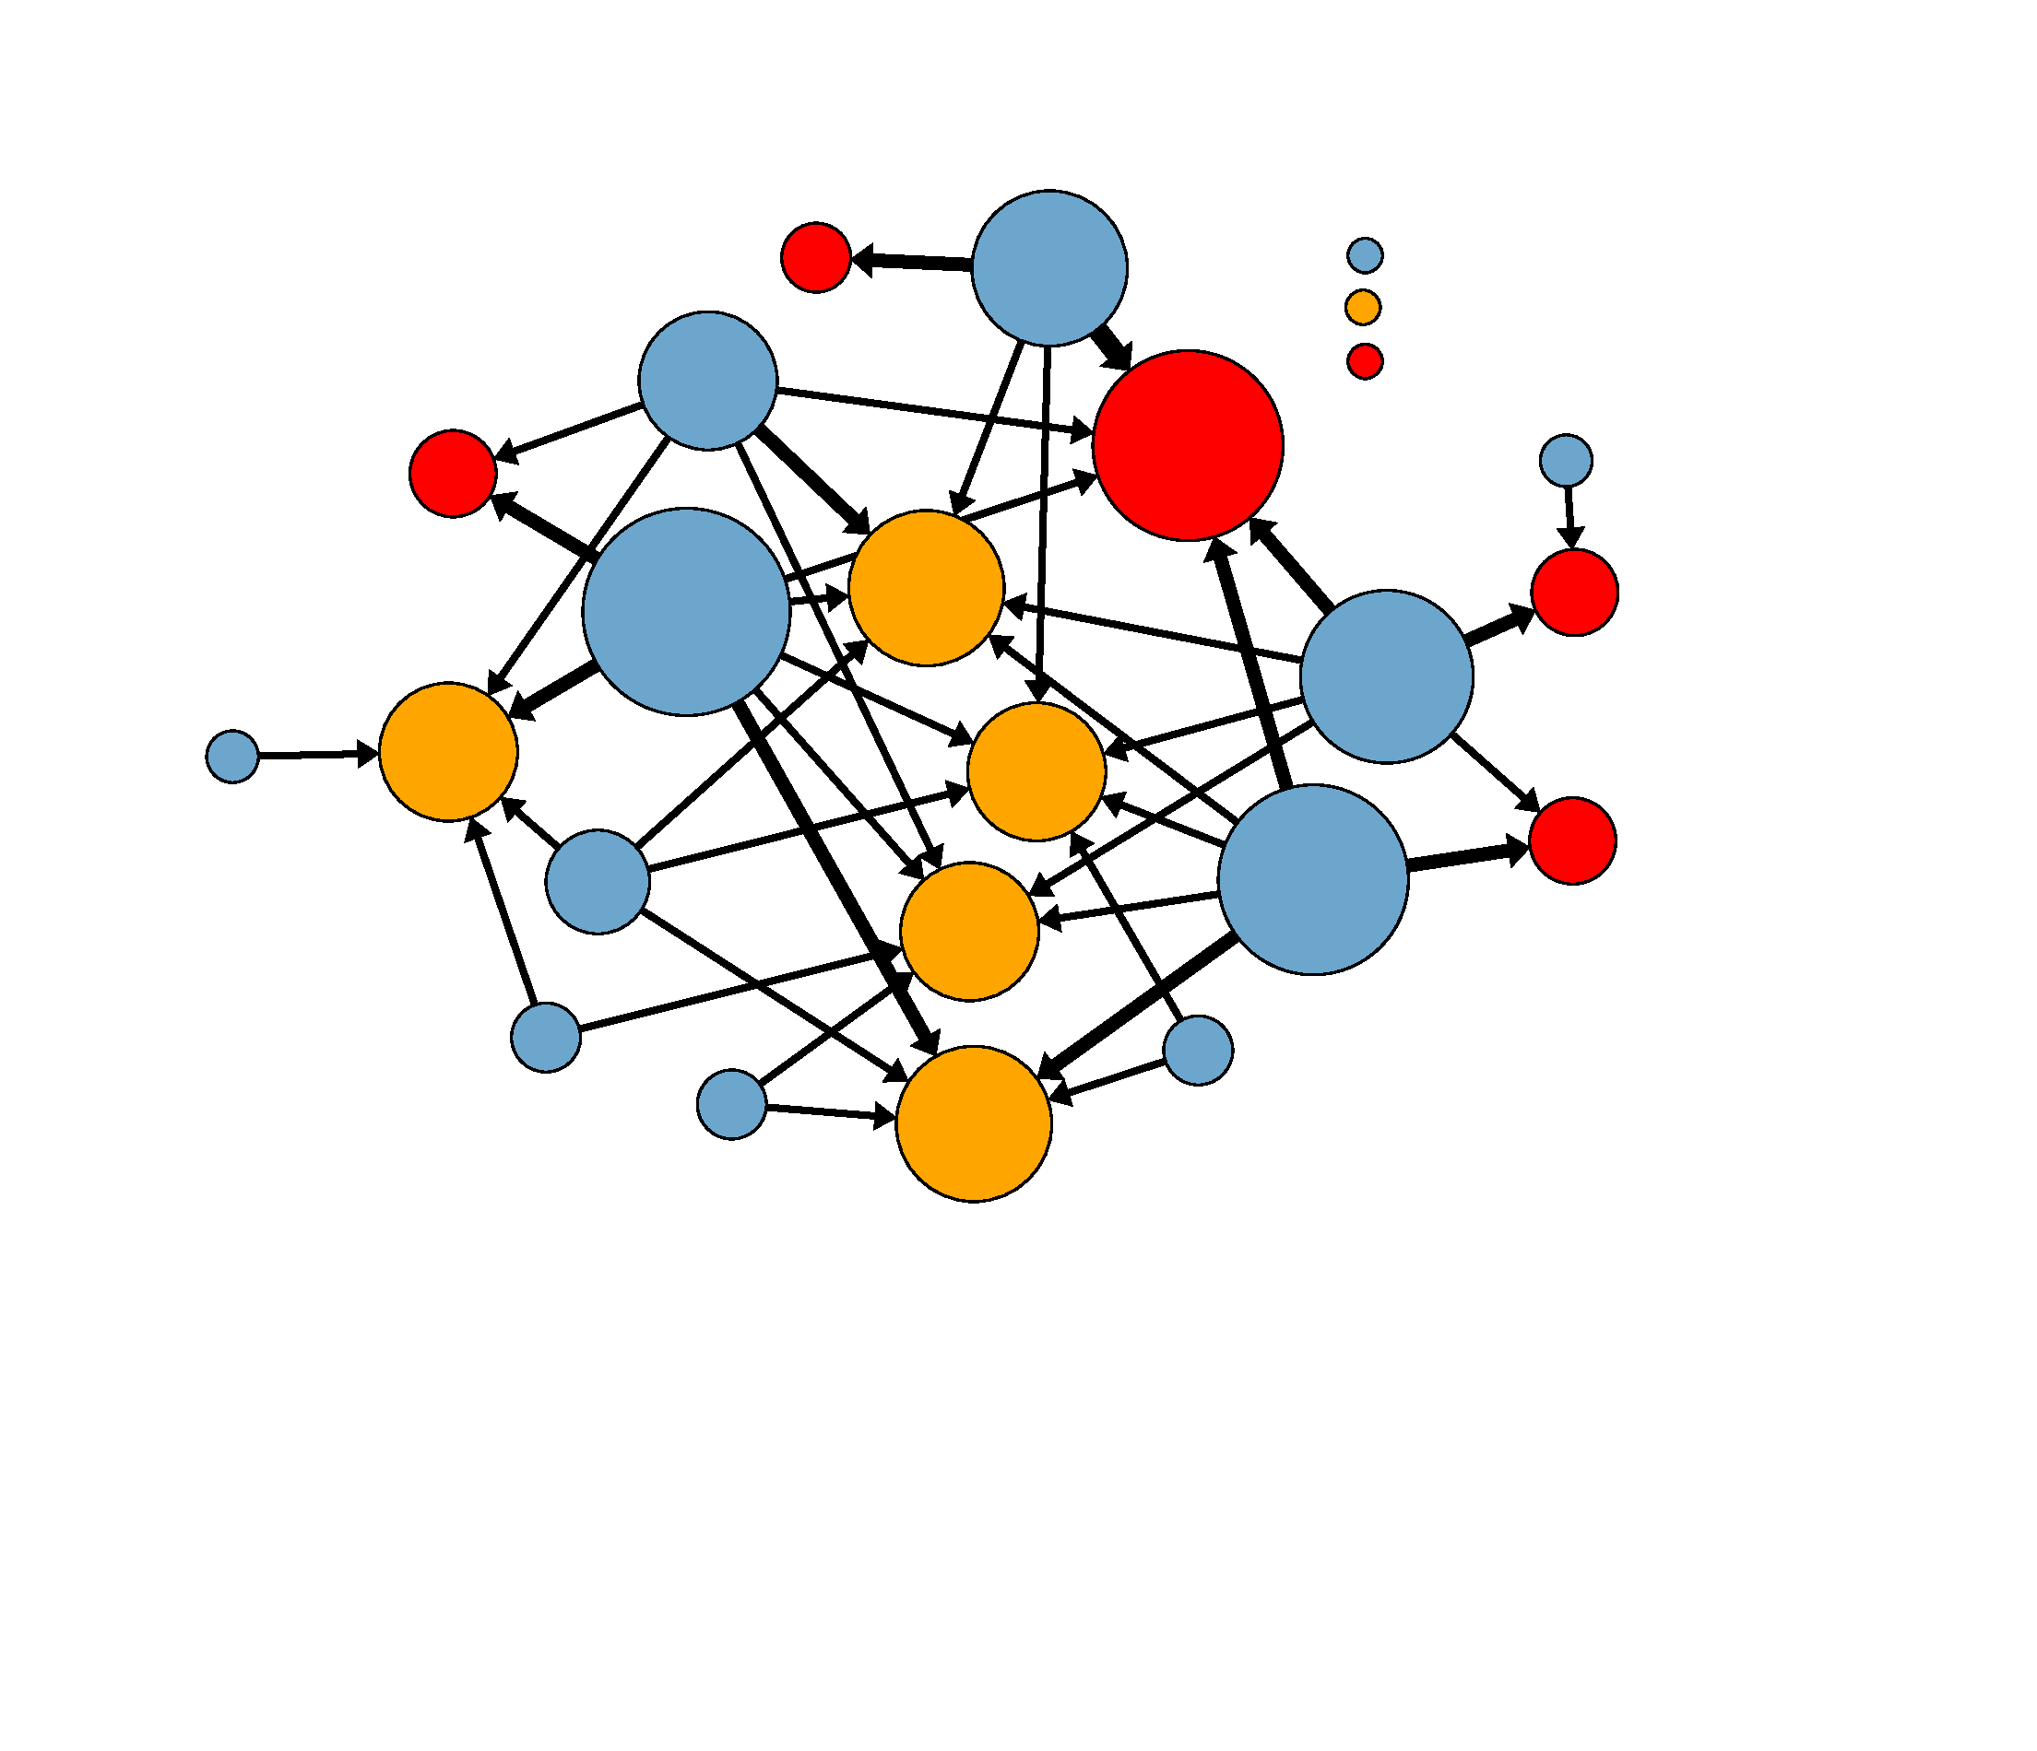
Mounting networks: Distantly and recently inseminated females were mounted
roughly equally
Male
Recently inseminated female
Distantly inseminated female
Larger circles = more mounts
Recently inseminated mean: 4.3 mounts/female Distantly inseminated mean: 3.6 mounts/female
Notes:
Okay so for results, I’ll start with showing some mounting networks. So in these networks, blue represent males while red circles are recently inseminated females and orange circles are distantly inseminated females. In this case, because we have mount networks, every edge/arrow represents mounts where thicker arrows correspond to more mounts and larger nodes also correspond to individuals either receiving more or in the case of males, performing more mounts. Unconnected circles show individuals who either were not mounted or males that did not perform mounts. And we’re always going to be paying attention to is the size of the red vs. orange as those are the two female treatments. And here, they’re roughly the same size meaning males were pursuing both types of females at relatively equal rates

Slide 17
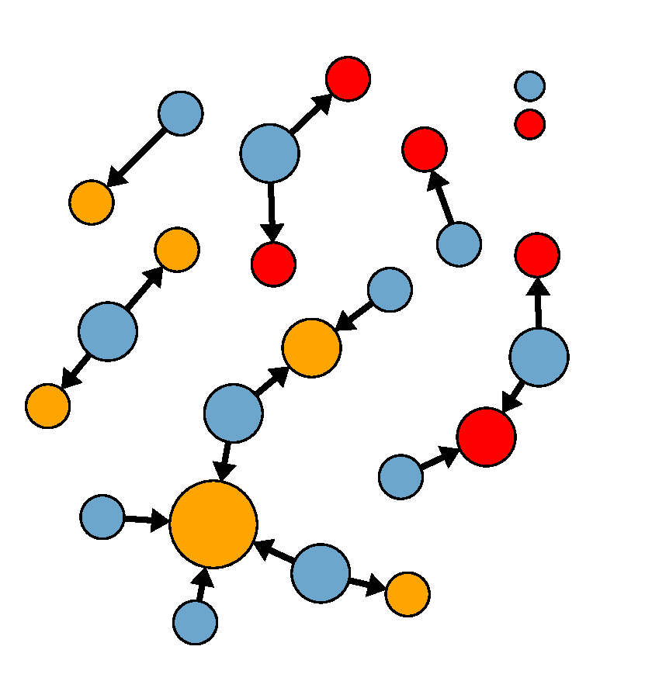
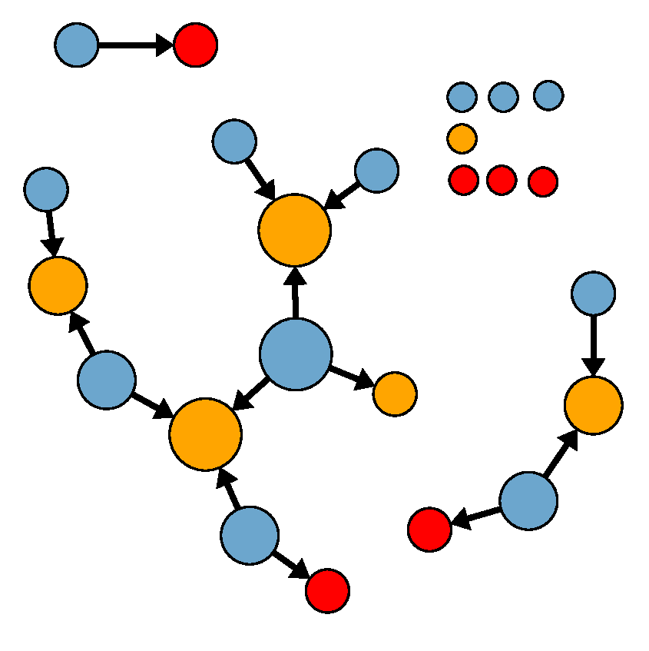
Insemination networks: Distantly inseminated females were inseminated more
Male
Recently inseminated female
Distantly inseminated female
Larger circles = more inseminations
Recently inseminated mean: 0.77 inseminations/female Distantly inseminated mean: 1.33 inseminations/female
Notes:
Interestingly, when you look at the insemination networks where the edges or arrows now represent inseminations, we now see the opposite trend of the orange circles seem larger showing that distantly inseminated females appear to get inseminated more. Though this is not statistically significant, here we’re looking at absolute number of insemination. However, if you take into account number of inseminations relative to mounts received…

Slide 18
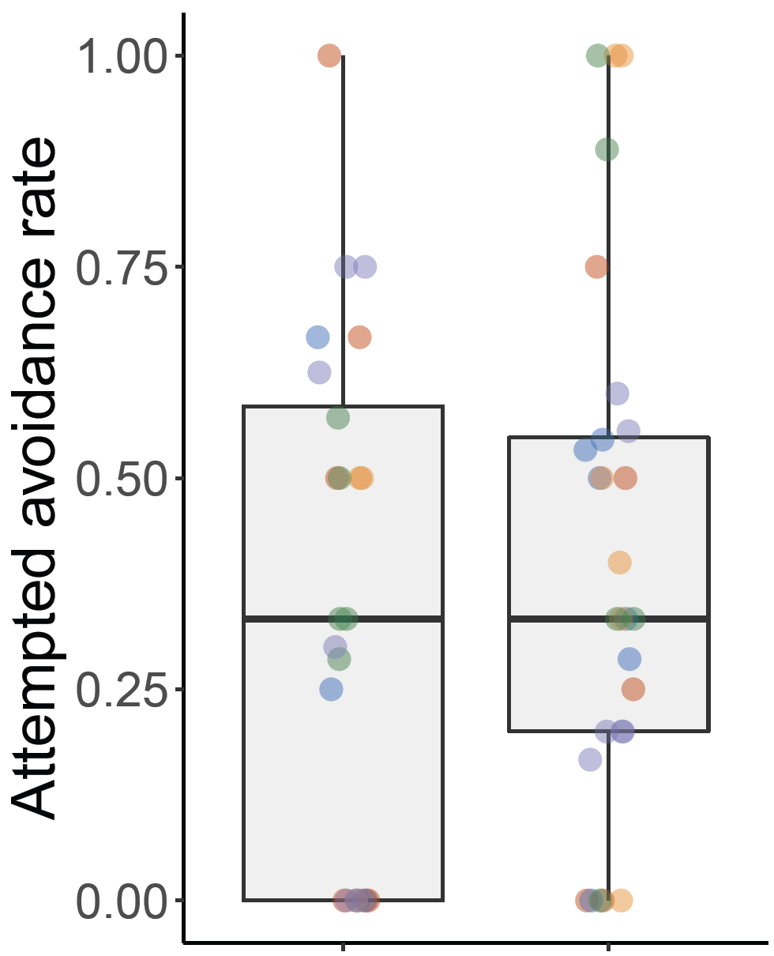
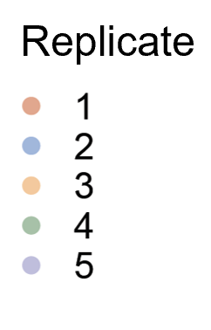
Female avoidance: Recently and distantly inseminated females evaded mounts at equal rates
n.s
Distantly inseminated
Recently inseminated
Notes:
We first found that, surprisingly… recently and distantly inseminated females attempted to evade mounts at equal rates.

Slide 19
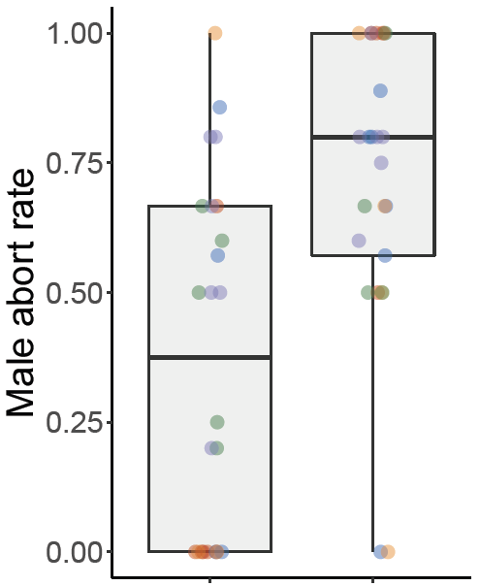
Male rejection: Males rejected recently inseminated females at higher rates (p < 0.01)
**
Distantly inseminated
Recently inseminated
Notes:
However, when it came to male abort rates, we do see that males are rejecting recently inseminated females at much higher rates.

Slide 20

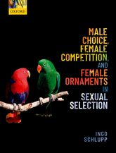

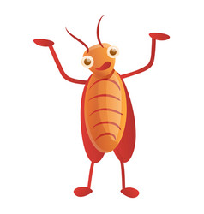



Insemination status affects the likelihood of a female getting inseminated
Driven by male choice as opposed to female avoidance
Our results add to the growing body of evidence showing that males can be choosy too!

Slide 21
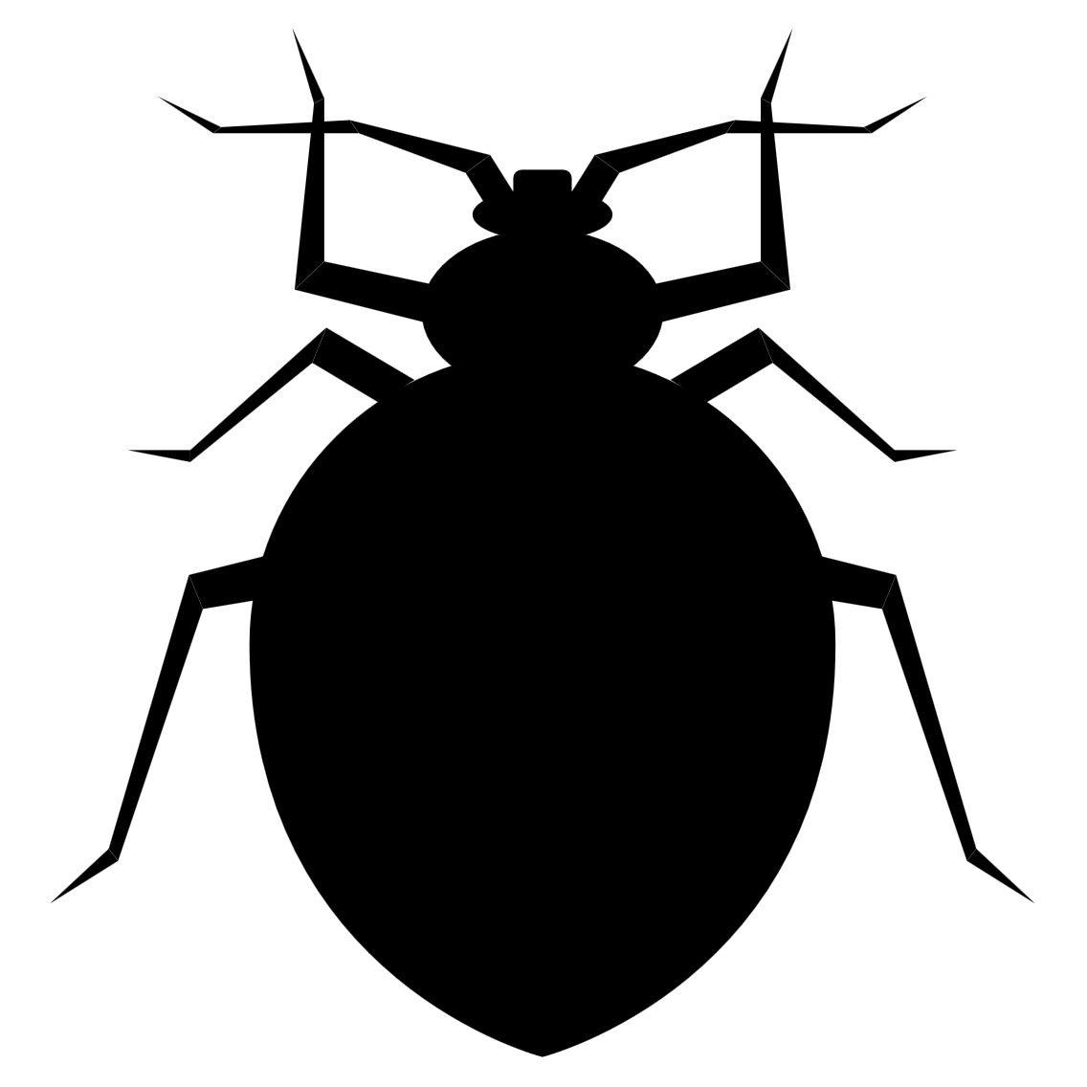

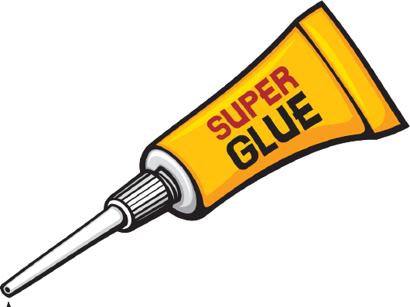
Quantifying the cost of natural insemination rates
Daily insemination
Natural insemination rate
Weekly insemination
+
Daily harassment
Low, sufficient insemination rate
Stutt and Siva-Jothy (2001); Morrow and Arnqvist (2003)
Notes:
And then obviously an open-ended question is why we still aren’t seeing predictable patterns of female avoidance?? And so what we want to do is first quantify the costs of a low vs. natural insemination rates to see if daily insemination really leads to reduced lifetime reproductive output in females because existing data on the costs associated with traumatic insemination are still inconclusive. And hopefully with the data we gather from these experiments, we’ll start getting a more complete picture of what’s going on in this super fascinating but complex mating system and further our understanding of the ways sexual conflict can shape reproductive strategies and behaviours.

Slide 22
Weekly inseminated females outlived daily inseminated females
Daily insemination
Weekly insemination

Slide 23
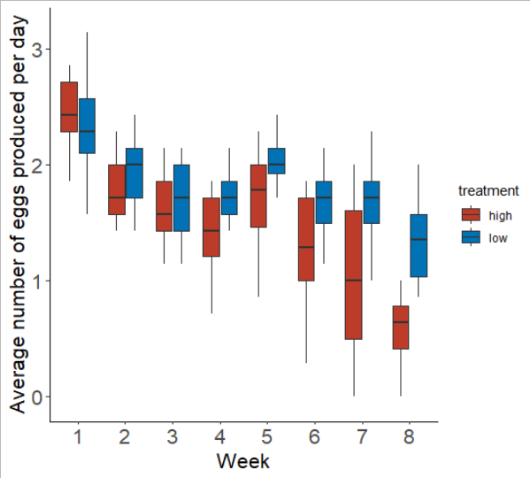
Weekly inseminated females produced eggs at higher rates compared to daily inseminated females
Daily insemination
Weekly insemination

Slide 24
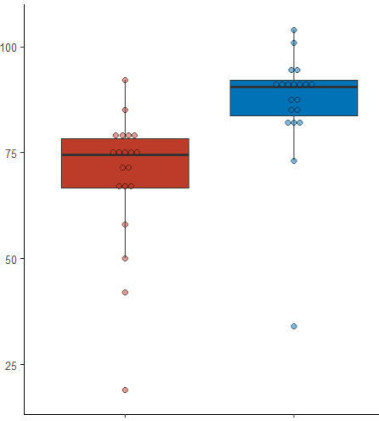
Weekly inseminated females produced more offspring compared to daily inseminated females
*
Lifetime number of
hatchlings produced per female
Daily insemination
Weekly insemination

Slide 25
The natural rate of insemination is costly to females and appears to be male controlled
*
Lifetime number of
hatchlings produced per female
Daily insemination
Weekly insemination

Slide 26
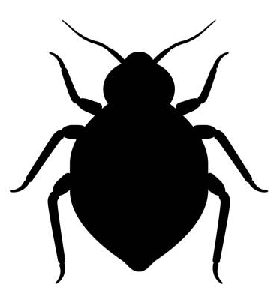

Next step: Quantifying sperm competition and precedence patterns

Slide 27

Next step: Quantifying female avoidance behaviour as number of prior
consecutive inseminations increases
Inseminated daily for six consecutive days
v
Virgin reference females

Slide 28
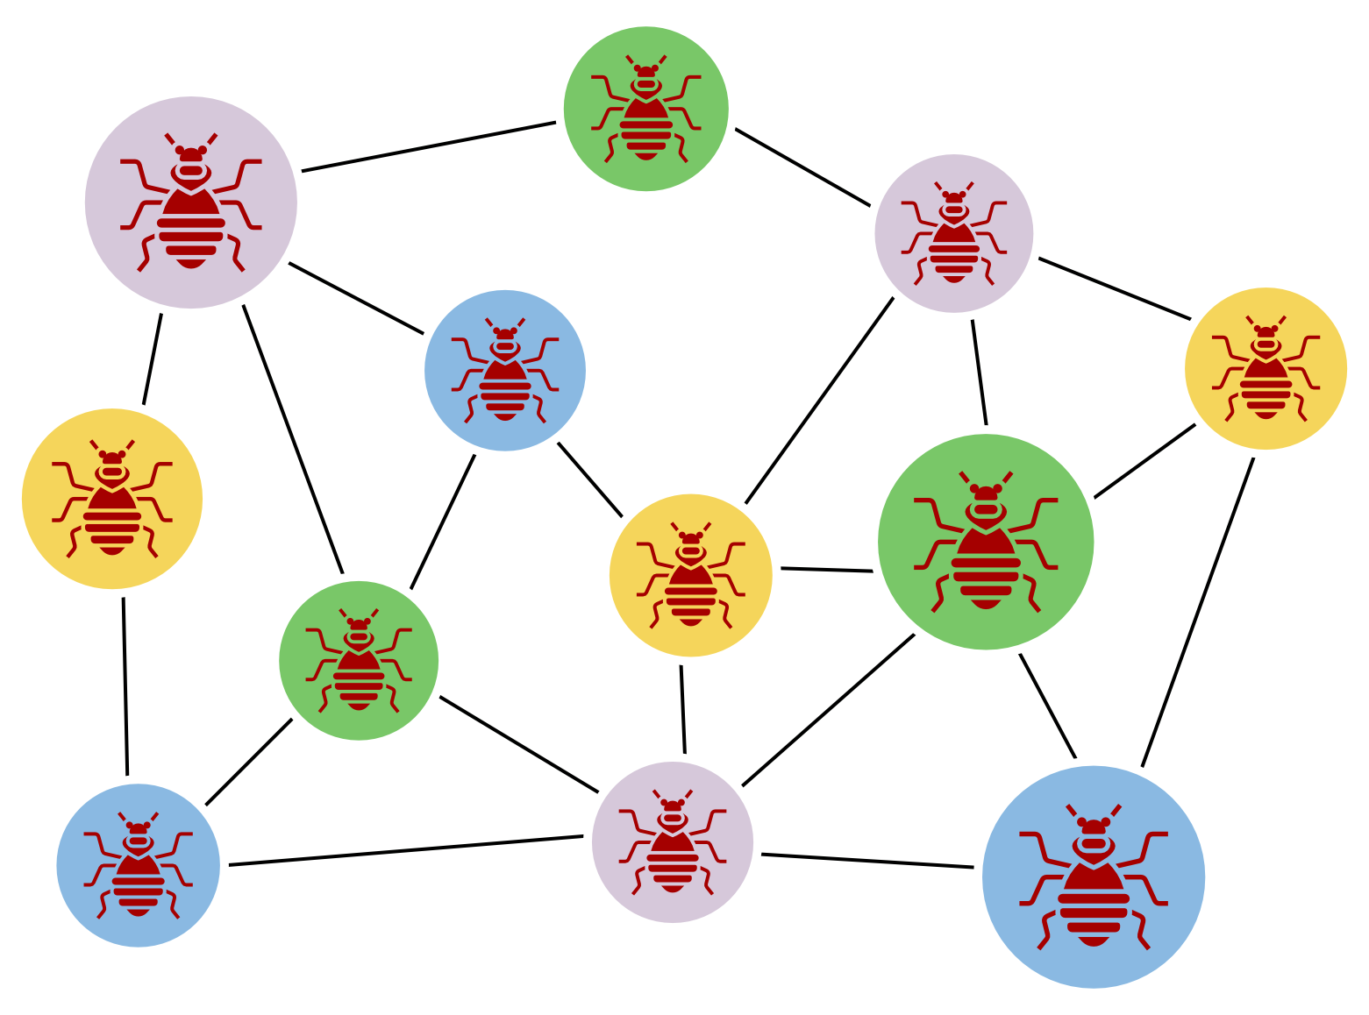
To conclude…
Bed bugs are a useful model for studying sexual conflict
Sexual conflict can have complex effects on social and sexual behaviour
Network analysis is a useful tool for studying these effects

Slide 29







Acknowledgements
Reuven Dukas
Maggie Dobbin Jack Rosembaum
Matthew John Yatharth Patel Rishitha Garapati Dave Thompson
Ben Bolker Jonathan Dushoff Dukas Lab
Notes:
With that, I just want to thank all of these incredible people for making this project possible and thank everyone here for tuning into my talk and I’ll be happy to take questions.

Slide 30

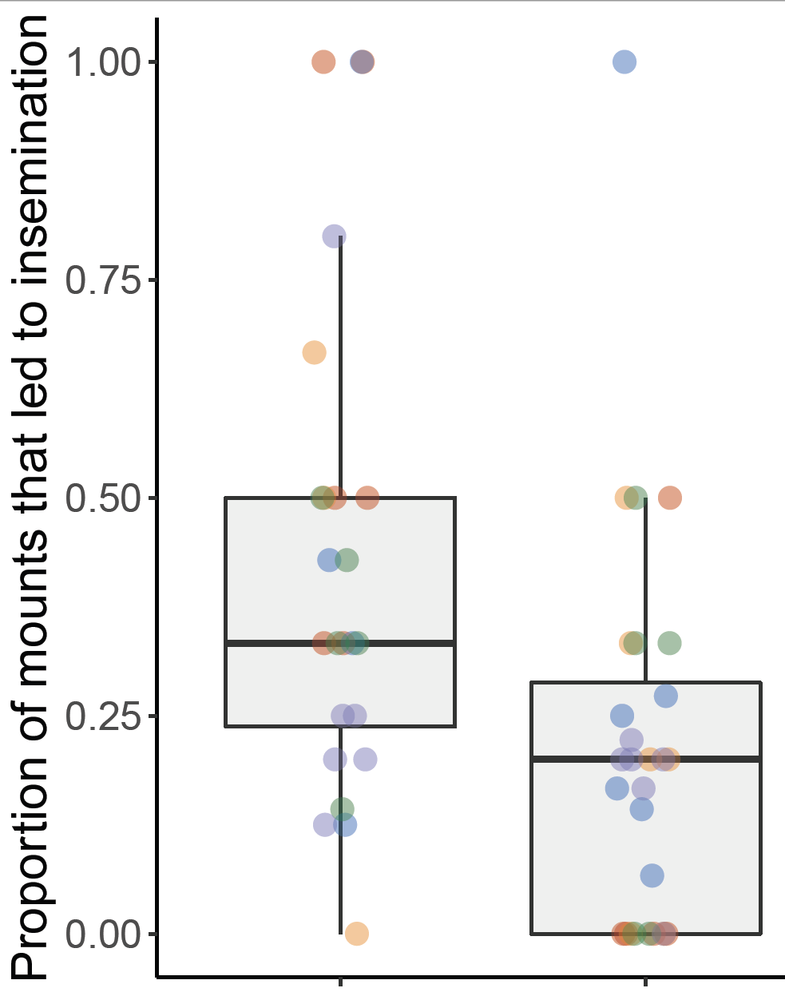
More mounts directed at distantly inseminated females led to insemination (p < 0.01)
Distantly inseminated
Recently inseminated
Notes:
We do see that a higher proportion of mounts directed at distantly inseminated females lead to insemination compared to the mounts directed at the recently inseminated females. So this is looking at insemination rate rather than just total number of inseminations… As for whether it’s female avoidance or male rejection driving this pattern…

Slide 31
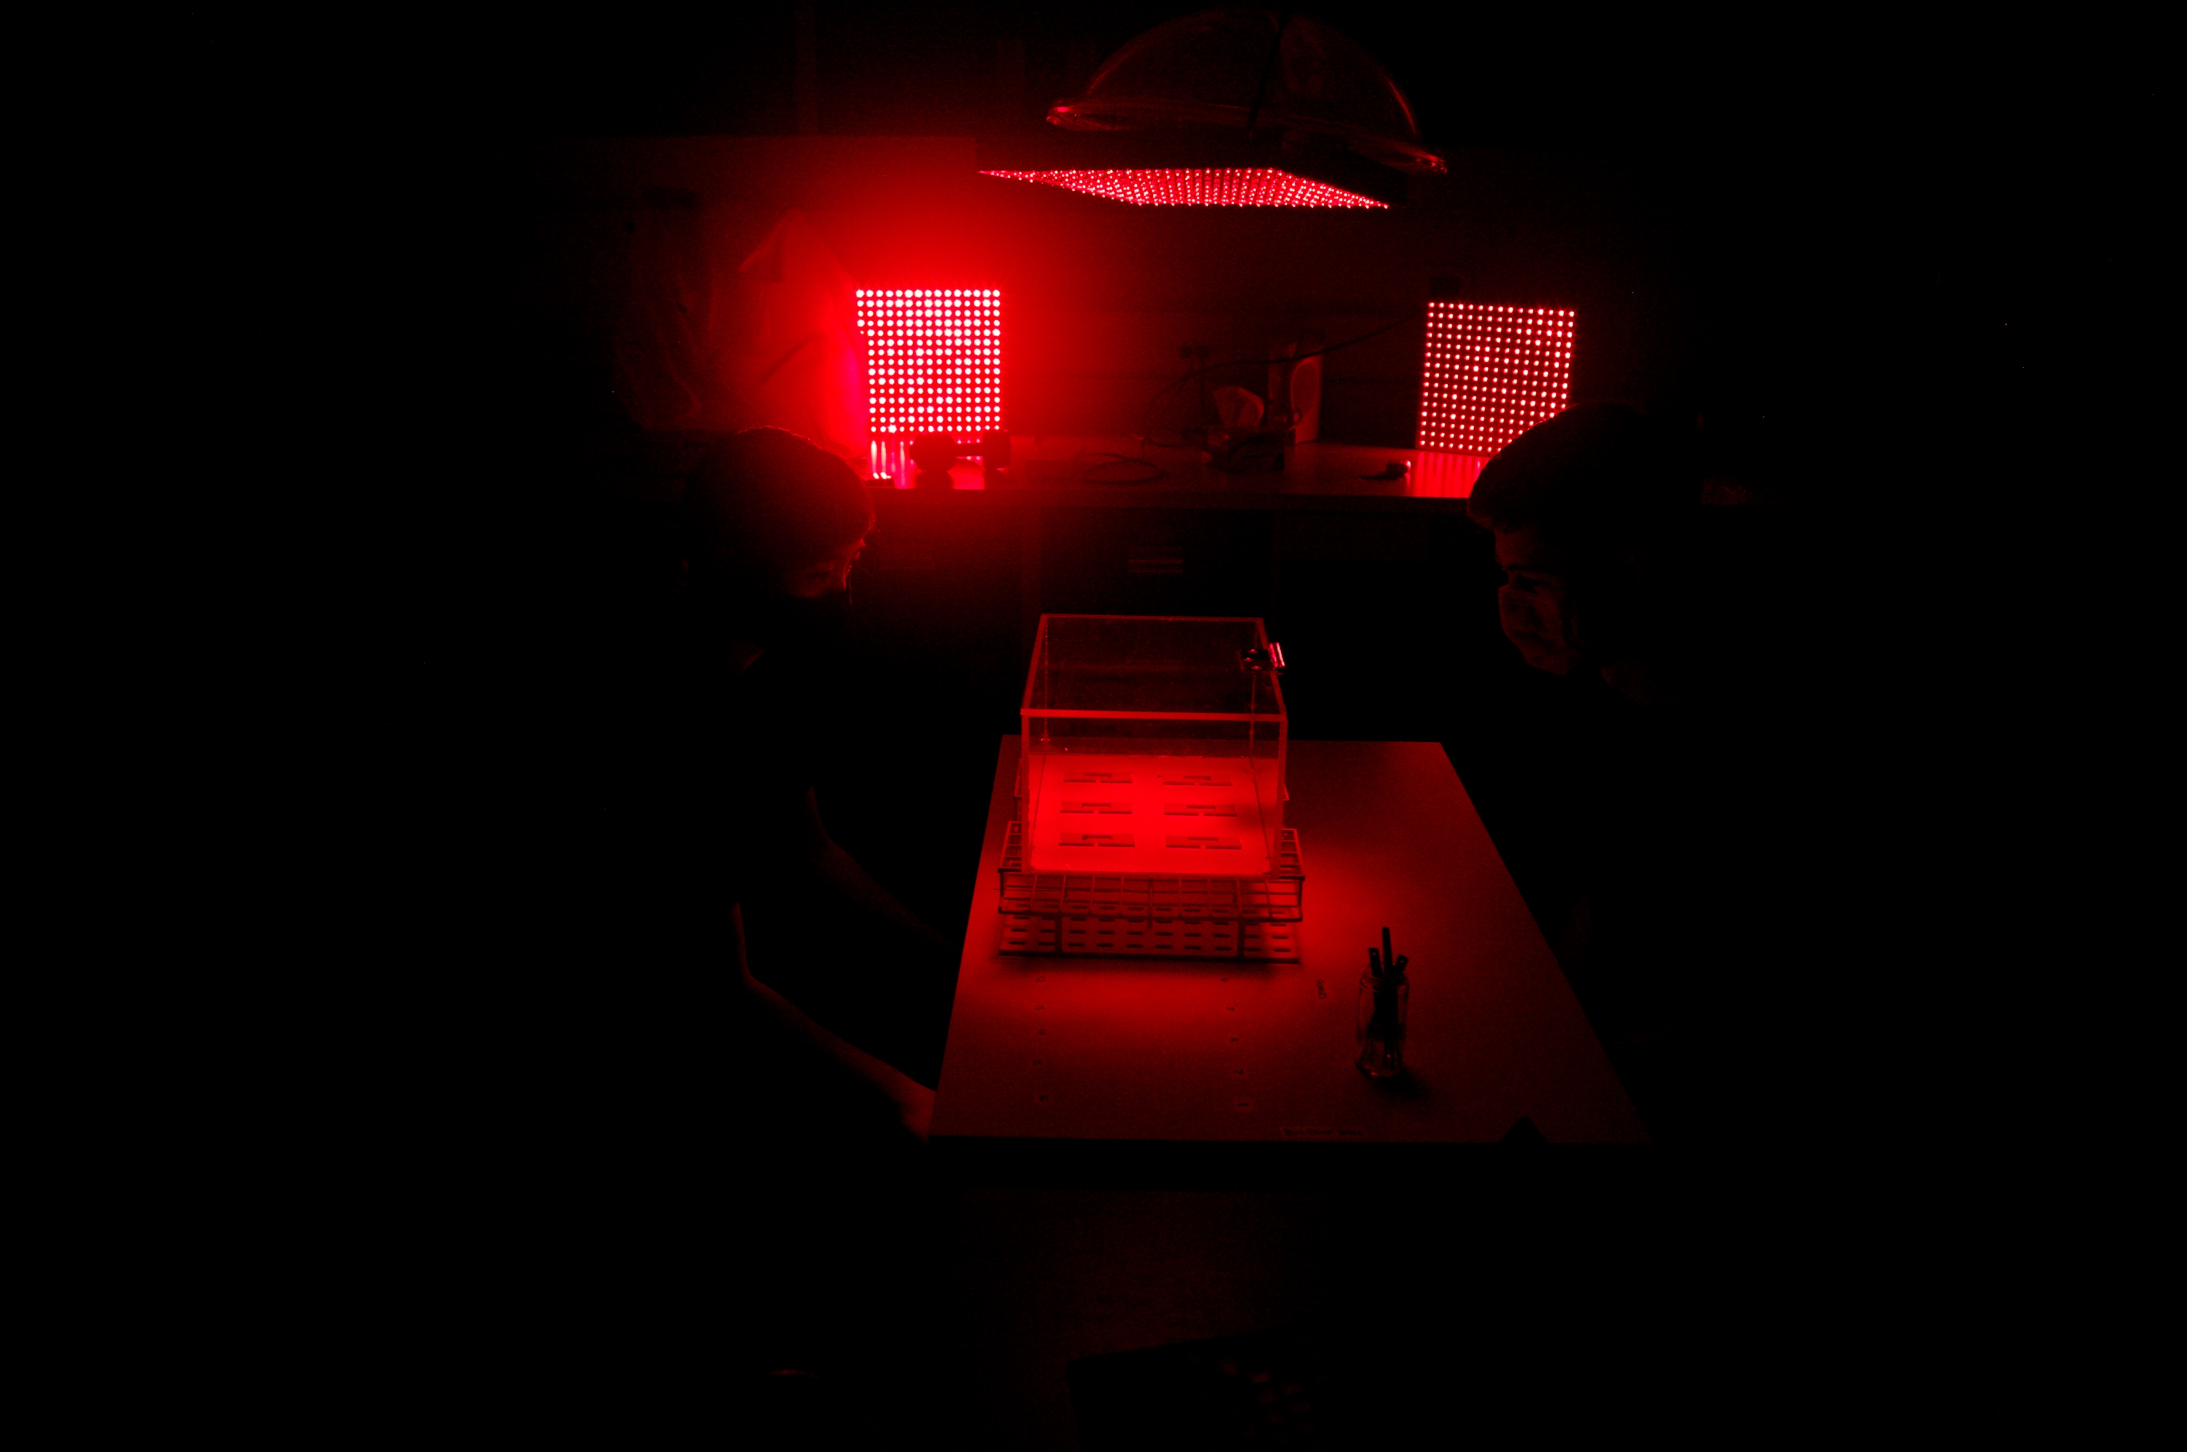
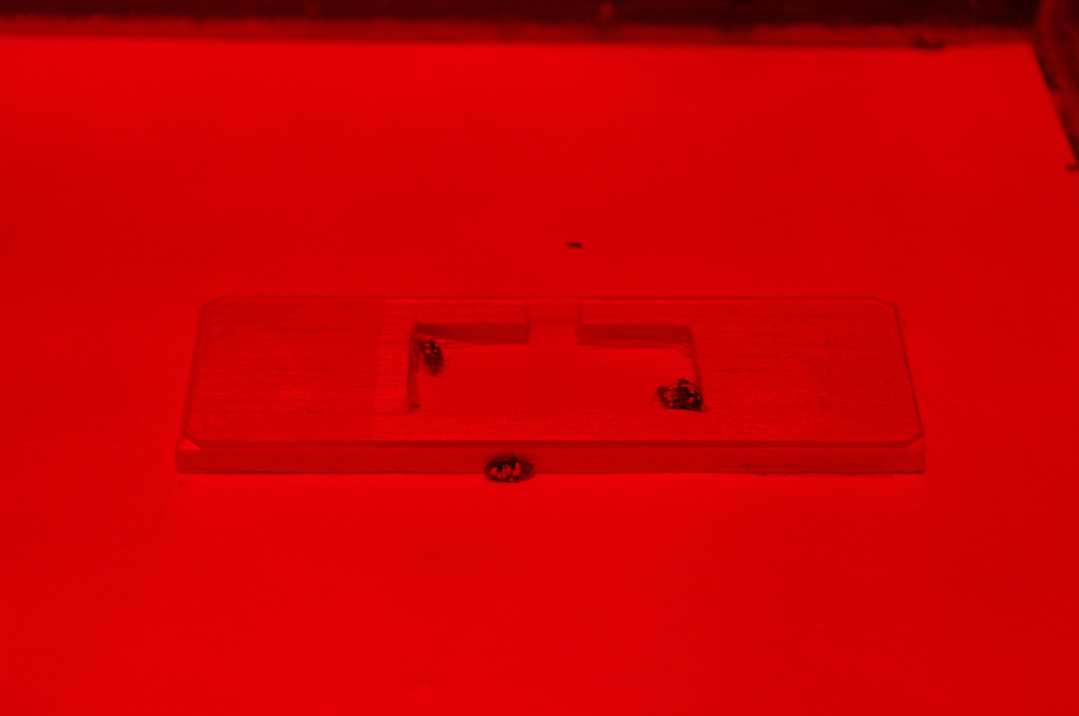
We live observed all sexual interactions for one hour where observers were blind to female treatment
Notes:
And then we live observed all sexual interactions for one hour, under red light because bedbugs are nocturnal, and made sure observers were always blind to female treatment.

Slide 32
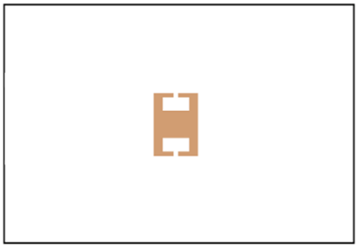
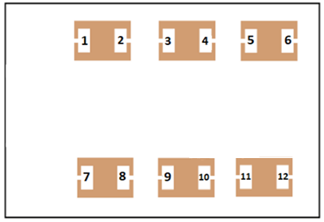
Treatments
2-shelter: Limited opportunities for female social avoidance strategies
12-shelter: Ample opportunity for female social avoidance strategies
1
2
2-shelter
12-shelter
Three replicates of each treatment
Yan and Dukas (in press)
Notes:
We also had two treatments. So we had a 2-shelter treatment which provided females with limited opportunities for social avoidance and a 12-shelter treatment which provided females with ample opportunity for social avoidance. And we ran three replicates of each treatment.

Slide 33
Females would evade sexual harassment by…
Male Female
1. Having fewer and weaker social connections
2. Aggregating more with other females (assortment by sex)
Pfiester, Koehler, and Pereira (2009)
Notes:
We then predicted that especially in the 12-shelter treatment where there’s more opportunities for social avoidance… that 2. Population level assortment by sex meaning we would often see aggregations that were either strongly male-biased or female-biased 3. Females would have fewer and weaker social connections overall as a means to avoid sexual harassment and multiple inseminations - Also hint from previous research which seemed to find higher proportion of lone females compared to lone males (no shelters)

Slide 34
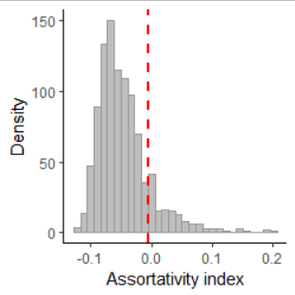
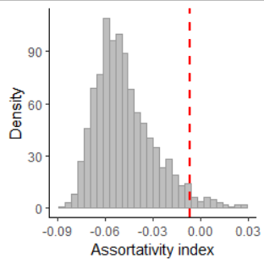
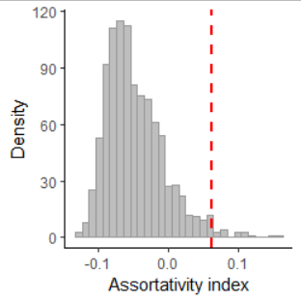
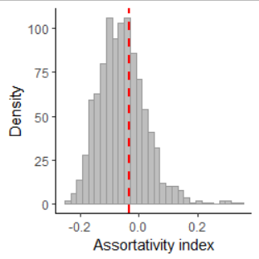
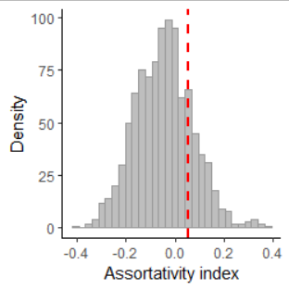
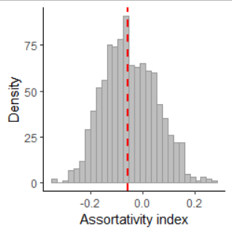
Aggregations were not assorted by sex
p = 0.28
p = 0.06
p < 0.05
p = 0.73
p = 0.38
p = 0.89
Yan and Dukas (in press)
Notes:
Figure 4. Distribution of assortativity indexes from permuted networks. The top row represents randomized networks from the 2-shelter treatment while the bottom row represents randomized networks from the 12-shelter treatment. Red dashed lines represents observed assortativity indexes.

Slide 35
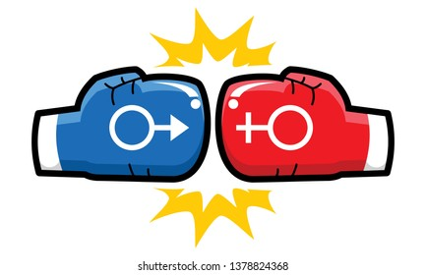
Social avoidance summary
In isolation, females prefer the company of other females
In larger groups, females are incapable of evading males through:
Weaker/less social connections
Aggregating with same-sex individuals
Sexual conflict over social situations
Notes:
Brief summary slide

